Slide 1

Advancing Million Hearts®:
AHA and Heart Disease and Stroke
Partners Working Together in Virginia
July 13, 2016
10:00 AM to 3:00 PM ET
American Heart Association
4217 Park Pl Ct
Glen Allen, VA 23060

Slide 2
Welcome!
What excites you about your role in heart disease and stroke prevention?

Slide 3
The Million Hearts® Initiative
Advancing Million Hearts in Virginia
July 13, 2016
Glen Allen, Virginia

Slide 4
Million Hearts®
Goal: Prevent 1 million heart attacks
and strokes by 2017
National initiative co-led by CDC and CMS in partnership with federal, state, and private sectors
To address the causes of 1.5M events and 800K deaths a year, $316.6 B in annual health care costs and lost productivity and major disparities in outcomes
4
Notes:
Million Hearts® is a national initiative, launched in January 2012 by the U.S. Department of Health and Human Services.
It is co-led by CDC and CMS and focuses on aligning and brining together the efforts of federal agencies, states, regions, communities and individuals on a common goal—preventing one million heart attacks and strokes by 2017
This goal is audacious and achievable only with the collective efforts of each of us as individuals and as members and leaders of our communities, workplaces, and organizations.
HHS asked CDC and CMS to bring their collective strengths to lead this initiative, ensuring the coordination of public health, clinical care and policy approaches to this complex problem.
We are delighted by the robust participation of private sector partners from states to health professional societies, health advocacy groups, and faith based organizations, and commercial payers to name a few.

Slide 5

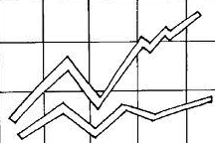
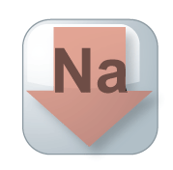



Key Components of Million Hearts®
Keeping Us Healthy
Changing the environment
Excelling in the ABCS
Optimizing care
Health Disparities
Focus on the ABCS
Health tools
and technology
Innovations in care delivery
TRANS
FAT
Glantz. Prev Med. 2008; 47(4): 452-3.
How Tobacco Smoke Causes Disease: A Report of the Surgeon General,2010.
Notes:
In order to prevent a million heart attack and strokes, we knew there was work to be done in changing the environments in which we live, work and play and in achieving excellence in our healthcare.
This slide outlines the key components of this needed work.:
By increasing smoke free environments, decreasing sodium in the food supply, and eliminating trans fat, we would change our environment in ways that keep people healthier and less likely to need health care. Were you aware that when communities go smoke-free, there is an immediate decrease in the number of hearts attacks seen in those communities? (“50 Years of Progress: A Report of the Surgeon General, 2014 page 442)
In addition to changes to our environment, we also need to help patients, healthcare professionals and systems achieve excellence in the care delivered. In the clinical arena, we can reduce heart attacks and strokes by:
Focusing the attention of patients, healthcare professionals and the systems in which they work, on the ABCS (Aspirin when appropriate, Blood pressure control, Cholesterol management, Smoking cessation);
Harnessing the power of health information technology to improve health outcomes;
Developing, testing, and deploying new models of care that recognize and reward outcomes and value.
[Click again and the Health Disparities box will pop up.]
As a nation, we can and must do better. For certain segments of our nation, the burden is even greater. As we work on changing the environment and optimizing care, we need to make sure we are addressing the needs of those who are disproportionately affected by cardiovascular disease.

Slide 6
Getting to a Million by 2017:
Public Health Targets
Intervention | Pre-Initiative Estimate 2009-10 | 2017 Target
Smoking prevalence* | 26% | 24%
Sodium reduction | 3580 mg/day | 2900 mg/day
Trans fat reduction | 0.6% of calories | 0% of calories
* Includes all forms of combustible tobacco – cigarettes, pipes, and cigars
National Survey on Drug Use and Health, National Health and Nutrition Examination Survey

Slide 7
Getting to a Million by 2017:
Targets for the ABCS
Intervention | Pre-Initiative Estimate 2009-2010 | 2017 Population-wide Goal | 2017 Clinical Target
Aspirin when appropriate | 54% | 65% | 70%
Blood pressure control | 52% | 65% | 70%
Cholesterol management | 33% | 65% | 70%
Smoking cessation | 22% | 65% | 70%
National Ambulatory Medical Care Survey, National Health and Nutrition Examination Survey
7

Slide 8
Million Hearts® Accomplishments*
Draft Voluntary Guidance to Industry Released June 1, 2016
Notes:
With support from national, state, and local partners, we have seen many accomplishments since Million Hearts® began.
This slide highlights a select set of notable ones, keeping in mind that there are many more across the country.
Since Million Hearts® began we have seen 4 million fewer cigarette smokers
More than 2 billion meals/year will have reduced sodium.
The FDA released draft voluntary guidance to industry on June 1 for public comment.
We consider the goal to eliminate artificial trans fat as being accomplished when FDA issued the final determination on artificial trans fat.

Slide 9
Million Hearts® Accomplishments
Notes:
Thanks to the work of Million Hearts® partners focusing on the ABCS, millions of American are now covered by health care systems that are recognizing and rewarding performance on the ABCS.
Over half a million patients have been identified as potentially having hypertension through the use of health IT tools.
And millions of dollars in public and private funds have been leveraged to focus on improving the ABCS.

Slide 10
Million Hearts Progress to Date
Engagement and activation
Clinical Quality Measure alignment
Understand what works, where, and why
Resources that help
Extraordinary support for prevention
Notes:
Million Hearts® has seen much engagement and activation from a variety of organizations.
Over 125 organizations have partnered with Million Hearts® and have committed to taking actions to support cardiovascular disease prevention
There are cvd prevention activities happening throughout all 50 states, DC and even the territories.
And over 325 faith-based congregations have committed to raise awareness about risks for heart disease and stroke and educate individual about prevention
To reduce the reporting burden on professionals and focus quality efforts to achieve the greatest impact on outcomes, Million Hearts® staff worked with public and private partners to align and embed a focused set of evidence-based clinical quality measures into major quality reporting initiatives. These measures represent key outcomes related to the ABCS.
Clinicians can find a list of the quality reporting initiatives that have measures aligned with Million Hearts® on the Million Hearts® website.
New and already established projects have been aligned with Million Hearts® to help us better understand what works, where, and why.
Examples of these include a the American Medical Group Foundation’s Measure Up. Pressure down. Campaign that challenged and helped medical groups achieve higher rates of hypertension control. Another is a CDC-funded project with the Association of State and Territorial Health Officials that funds states to focuses on rapid improvement in identifying or controlling those with hypertension by bringing together partners across sectors including clinical, community, and public health.
Million Hearts has brought together key subject matter experts to develop resources to improve cardiovascular health including a Health Eating Center, action guides for clinicians, public health practitioners and employers, and protocols.
We have also seen extraordinary support for Million Hearts® across many federal programs.

Slide 11
Million Hearts®
Hypertension Control Champions
59 Champions
Representing
Solo to 70,000 Clinicians
Serving over 13 million people
>70% Control Rate
Practices and systems achieved control rates > 70%
Champions used evidence-based strategies
  Hypertension treatment protocols
  Self-measured blood pressure monitoring
  Frequent check-in’s
  Registries and proactive outreach
  Team-based care.
Next Million Hearts® Hypertension Control Challenge planned for launch in Feb 2017
Notes:
Million Hearts® has an annual Hypertension Control Challenge that identifies and recognizes health care professionals, practices, and systems that achieved blood pressure control for ≥70% of their patients.
The goals of the challenge are to:
Document and bring attention to standard and innovative system-level processes or approaches used by high performers
Improve understanding of successful implementation strategies at the health system level
Motivate individual practices to strengthen their hypertension control efforts.
To enter the Challenge, participants complete the nomination form which includes information such as on the size of the population served, the calculated HTN prevalence and control rates, and information about what has led to the current control rate.
To date, Million Hearts® has recognized 59 Hypertension Control Champions. Together these Champions include approximately 70,000 Clinicians serving over 13 million people through a variety of evidence-based strategies such as HTN treatment protocols,
The next Challenge is planned to launch in February 2017.

Slide 12
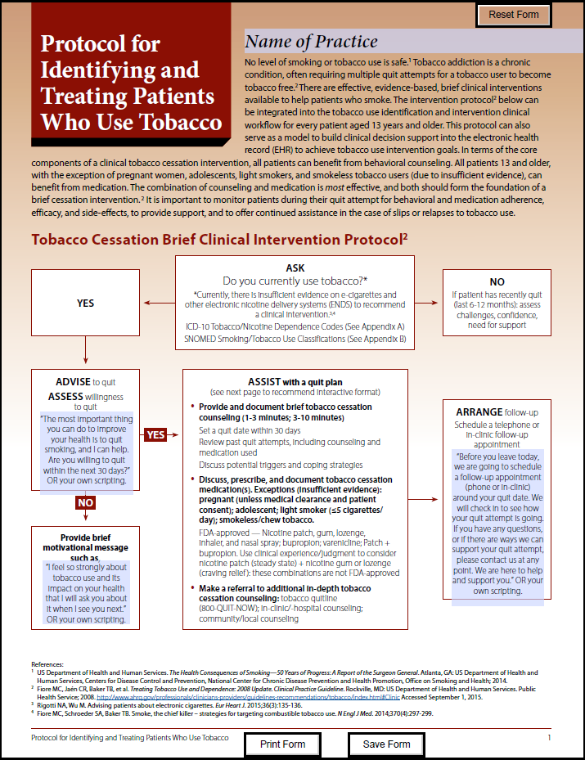
Standardizing Treatment through Protocols
Hypertension Treatment Protocol
  Use is on the Rise
  All Indian Health Service clinical settings
  Many Federally Qualified Health Centers
  Practices supported by CMS’ Quality Improvement Organizations
Tobacco Treatment Protocol
  Released a Tobacco Treatment Protocol in May
  Customizable templates
  Implementation guidance
    - coming in July
Notes:
Practices supported by CMS’ Quality Improvement Organizations
Q3 2015: 766 of 2911 (26%) were using a protocol
Q4 2015: 2399 of 7,058 (34%) were using a protocol
Q2 2016: over 1.5M patients are receiving protocol-driven care
Released a Tobacco Treatment protocol in May
Like the HTN treatment protocol, the tobacco protocol has customizable templates so practices can best customize to their needs.
- We are planning on releasing a guide to help with implementation in July.

Slide 13
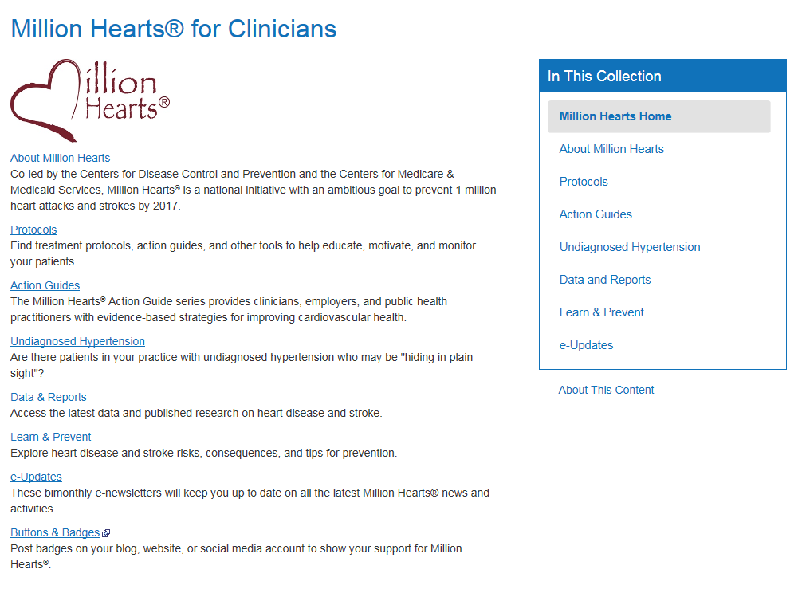
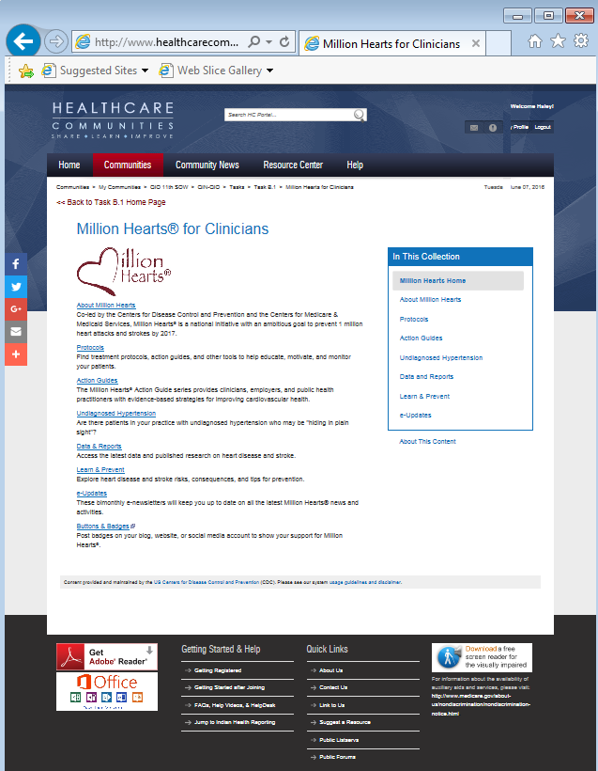
Million Hearts® Microsite for Clinicians
Syndicated for your website audience
Customized for your site’s size and color pallet
Brand it with your logo
Content is continuously maintained by CDC
The microsite and embed code will be available at https://tools.cdc.gov/medialibrary/index.aspx#/results

Slide 14
  What Must Happen To Prevent a Million?
Year-round media campaigns; pricing interventions
Targeted outreach to drive uptake of covered benefits
Systematic delivery of cessation services through use of cessation protocols, referrals to quit lines, and training of clinical staff
Widespread adoption of smoke-free space policies
Awareness of risks of second-hand smoke and the health benefits of smoke-free environments
Reduce Smoking
6.3M fewer smokers
Detection of those with undiagnosed hypertension
Systematic use of treatment protocols & other select QI tools
Practice of self-measured BP monitoring with clinical support
Recognition of high performers; dissemination of best practices
Connection of clinical & community resources to benefit people with HTN
Enhanced medication adherence
Intense focus on those with high burden and at high risk
Control Hypertension
10M more patients
Adoption of Healthy Food Service Guidelines
Voluntary sodium reduction and expansion of choices by food industry
Recognition of high performers and dissemination of best practices
Clear communication of the evidence supporting the health benefits of population-level sodium reduction
Decrease Sodium Intake
20% reduction
Events will also be prevented by improving aspirin use, cholesterol management,
and utilization of cardiac rehab, and by eliminating artificial trans-fat consumption
Notes:
Evidence-based strategies to prevent a million: This is how Million Hearts makes the biggest impact.
When organizations are considering how to align their efforts with Million Hearts, the strategies on the right are an excellent place to start.

Slide 15
Focus of 2016
Smoking cessation
  Facilitate implementation of tobacco cessation protocols
  Promote smoke-free spaces
Hypertension control
  Facilitate use of self-measured BP monitoring, treatment protocols, and processes to find the undiagnosed
  Share best practices by promoting action guides that identify and control hypertension
Sodium reduction
  Advance adoption of procurement guidelines
  Disseminate healthy eating resources
Notes:
That leads us to what we want to focus on in 2016, in order to Finish Strong
Here are some action steps that organizations can consider to help meet the Million Hearts® goal of preventing heart attacks and strokes.

Slide 16
Focus of 2016
Cholesterol management
  Implement statin measure across clinical settings
  Support partner actions currently underway
Cardiac rehab
  Facilitate collective actions to increase referral and participation
Embed ABCS measures in value-based models
Capture and tell the story of your success
Recognize high performers & share best practices
  Learn about the successes of the Hypertension Control Champions and share their lessons learned.
Notes:
Cardiac Rehab
Facilitate collective actions to increase referral and participation in cardiac rehab programs.
A Million Hearts® Cardiac Rehab Collaborative (CRC) came together in February and meets quarterly to share and accelerate progress in this area.
[NOTE TO PRESENTER: The CRC welcomes those that are ready to take action to join these meetings. To learn more, send questions to millionhearts@cms.hhs.com]

Slide 17
3 Phase Framework for Million Hearts
January 2016-July 2017
Primary Activities, Timelines, and Deliverables
Finishing Strong
January to December 2016
Plant and push key actions
Measure and report impact
Collect and tell stories
Celebrate
Transition Zone
March 2016-July 2017
Gather input from stakeholders
Incorporate findings of evaluation and modeling
Set framework, metrics, budget
Engage partners, leadership
Disseminate final report
Million Hearts 2.0
January - July 2017 Launch
Issue new aim and targets
Ignite novel collaborations
Gather powerful commitments
Serially launch at events in 1st 6 months
Cogent Final Report
Refreshed, Bold, Engaging Initiative
Bigger, Deeper Impact
Notes:
Finishing Strong: Million Hearts wants to show impact and results as well as; acknowledgment of partners and participants; and summary of lessons learned.
Transition Zone March 2016-July 2017: During this planning period Million Hearts® will seek and incorporate input from others so the result is an initiative that resonates with those who can implement it.
Bigger, Deeper Impact.: By July 2017, Million Hearts® is working to launch a program that builds on the strengths of the first 5 year effort in order to prevent CVD and improve CV health.

Slide 18
Million Hearts® Resources
Hypertension Control: Change Package for Clinician
Hypertension Treatment Protocols
Self-Measured Blood Pressure Monitoring: Action Steps for Public Health Practitioners
  Cardiovascular Health: Action Steps for Employers
  100 Congregations for Million Hearts
Million Hearts Healthy Eating & Lifestyle Resource Center
  Million Hearts® E-update
Visit www.millionhearts.hhs.gov to find more resources
Notes:
Handout in today’s packet captures some of these resources: I particularly want to highlight these….

Slide 19




Subscribe—and Contribute to the E-Update
Commit to key action steps
Work together to prevent heart attacks and strokes
Thank You
Notes:
Spread the word, share with your networks, and check out our resources and tools on our website.
For those that organizations that aren’t clinically focused, look at goals and think about what you can do within the scope of your work/organization to promote these action steps
Stay tuned for Million Hearts 2.0. If you have meetings or events planned for the first 6 months of 2017 and would like to feature a Million Hearts 2.0 kick-off, please let us know

Slide 20
Virginia Chronic Disease Domain Programs that Align with
Million Hearts®

Slide 21
Million Hearts Learning Collaborative (ASTHO)
Aim Statement
Virginia Team will design a (regionally targeted) system of care that will increase hypertension control and reduce undiagnosed hypertension among high risk populations.
Potential Reach
The Behavior Risk Factor Surveillance System indicates that there are approximately 252,500 people with hypertension living in Cumberland Plateau, Peninsula, and Richmond City.
Process
PDSA test cycles to aggressively test tools, methodologies, and systems to maximize opportunities for improvement and positive patient outcomes
Notes:
Key Partners
Virginia Department of Health
Peninsula Health District
Community Care Network of Virginia
Richmond City Health District
Virginia Community Healthcare Association
Cumberland Plateau Health District
Southeaster Virginia Health Services (FQHC)
Insurers (e.g., Anthem)
Daily Planet (FQHC)
Walgreens
Capital Area Health Network (FQHC)
American Heart Association
Horizon Health Services (FQHC)
Family Practitioner
Virginia Hospital and Healthcare Association
Health Information Technology (Virginia Health Institute, Center for Innovative technology)
Medicaid
Virginia Health Quality Center (QIO)

Slide 22
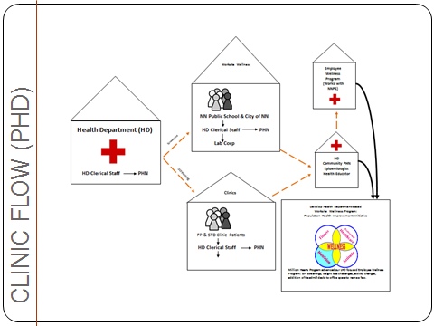
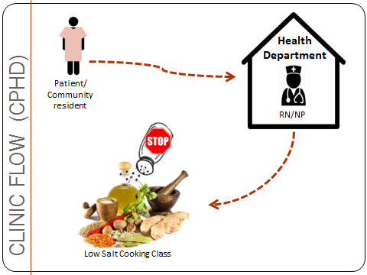
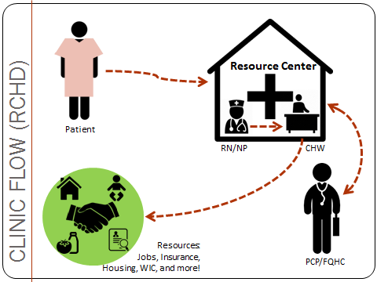
Work Flows
Notes:
In the revised version, the CPHD Health Educator (RN) screened women for hypertension in the Breast and Cervical Cancer Early Detection Program’s (BCCEDP) clinic.
Peninsula Health Department’s (PHD) change diagram reflects the partnership between the health department, the business community and the general community.
Richmond City Health District’s (RCHD) change diagram reflects the partnership between the health department, primary care physicians, and the community.

Slide 23

Virginia Congregations Blood Pressure Ministry Event Planning Guide
Million Hearts Initiative for congregations of all faiths.
Virginia is #1 nationwide with >150 congregations enrolled.
Local Health Departments and CHWs at the grassroots level.

Slide 24
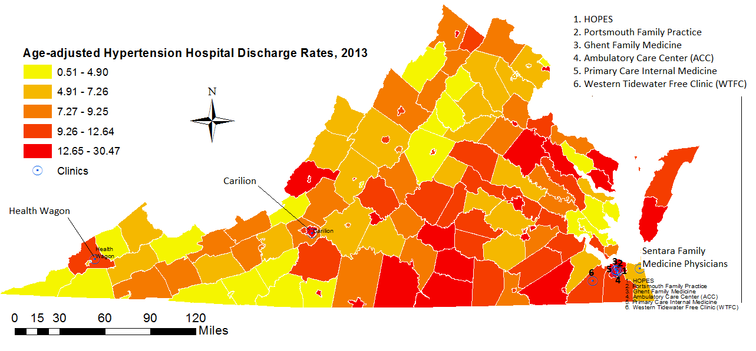
Check.Change.Control.
Number of patients identified as hypertensive
Defined as an average systolic blood pressure (SBP) ≥140 mmHg or an average diastolic blood pressure (DBP) ≥90 mmHg, or currently using blood pressure (BP)–lowering medication.
Number of patients identified as having uncontrolled hypertension
Defined as an average SBP ≥140 mmHg or an average DBP ≥90 mmHg, among those with hypertension.
Notes:
Number of patients identified as hypertensive
Defined as an average systolic blood pressure (SBP) ≥140 mmHg or an average diastolic blood pressure (DBP) ≥90 mmHg, or currently using blood pressure (BP)–lowering medication.
Number of patients identified as having uncontrolled hypertension
Defined as an average SBP ≥140 mmHg or an average DBP ≥90 mmHg, among those with hypertension.

Slide 25
Self-Measured Blood Pressure Monitoring (SMBP)
Virginia Hospital & Healthcare Association
Survey on SMBP policies targeting providers and pharmacists
  Lack of SMBP policies, coverage, education, etc.
Marketing campaign
  Video would be the best tool to use to target providers and patients
  Short Version (2 minutes) – Why?
  Long Version (4 minutes) – How?
Notes:
Does this video make you more likely to self monitor your blood pressure?”
Yes: “The steps to properly do it motivated me to check, and understand the top/bottom numbers.”
No: “I’m not currently at risk for high blood pressure and don’t have a need yet to purchase a home monitor. If my doctor indicates concern about my blood pressure I would get a home monitor and then periodically check my levels.”

Slide 26

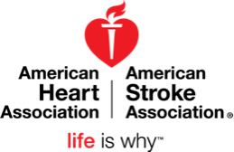
Overview of the
American Heart Association and
Programs and Resources
that align with Million Hearts®

Slide 27
Mission
Building healthier lives, free of cardiovascular diseases and stroke.
Our 2020 Impact Goal
By 2020 to improve the cardiovascular health of all Americans by 20% while reducing deaths from cardiovascular diseases and stroke by 20%.
Notes:
Set tone – here is our mission
Our 2020 impact goal
Factors we are looking at to get at improved cardiovascular health of all Americans by 2020
- A mixture of health factors and health behaviors – otherwise known as life simple 7:
- Smoking, physical activity, health diet, bmi, cholesterol, blood pressure, glucose

Slide 28
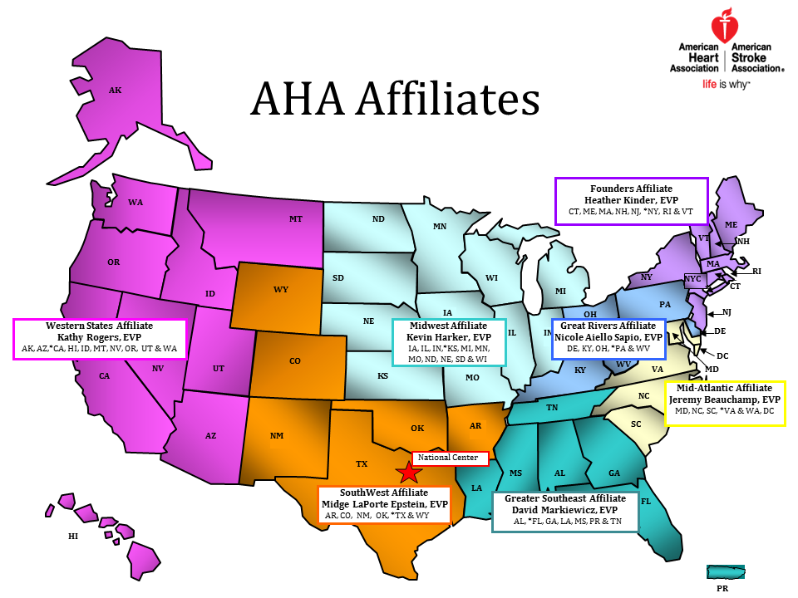
Notes:
Structure
Headquarters Dallas
seven affiliates
3,000 staff members;
150 office across the country
Each office slightly different
Roles may include:
Advocacy
Communications
Community Health
Development
Leadership
Multicultural
Quality
Other
Address VA

Slide 29
Building a Culture of Health
A culture in which people live, work, learn, play and pray in environments that support healthy behaviors, timely quality care and overall well-being.
Notes:
Building a culture of health –
To achieve this, we must work together, in partnership to make the healthy choice the easy choice in all the places where we live, work, learn, play, pray and heal.
To impact millions, we must focus on more than just individual behavior change
Need scalable, sustainable, and equity-addressing solutions.
Focus on focus on improving environments through policy and systems change and address social determinants of health

Slide 30
AHA and Million Hearts®
Spotlight on Virginia
Multicultural Health Priorities
EmPowered to Serve
Local faith based Million Hearts initiatives
Check.Change.Control

Slide 31
AHA and Million Hearts®
Spotlight on Virginia
Quality Systems Priorities
Get With The Guidelines
The Guideline Advantage
Target BP

Slide 32
AHA and Million Hearts®
Spotlight on Virginia
Advocacy Priorities
Healthy Food Financing
Medicaid Expansion
Healthier Food Choices in Public Places
Tobacco Prevention and Control

Slide 33
Tools and Resources
Online Tools
Heart 360
My Life Check
Heart Attack Risk Calculator
High Blood Pressure Risk Calculator
AHA’s Smoking Cessation Tools and Resources
AHA Healthy Workplace Food and Beverage Toolkit July 2016
Resources
EmPowered to Serve
Get With The Guidelines
Check.Change.Control

Slide 34
Discussion Questions
Is there a program you were unaware of that you would like to explore further for implementation or application in the state?
On which topics would you like additional information?
Other questions?

Slide 35
LUNCH BREAK

Slide 36
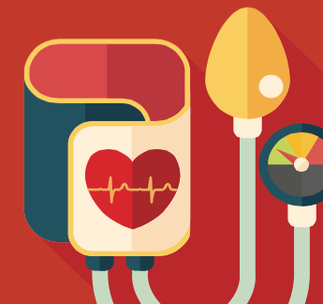

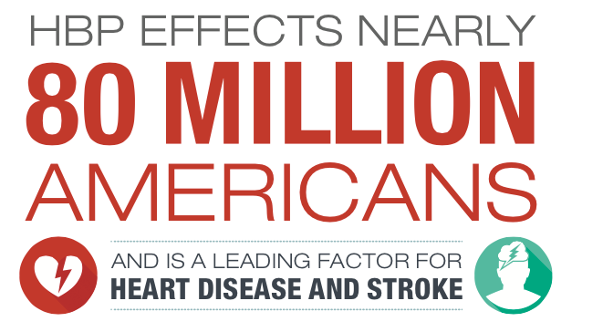
Advancing Million Hearts®:
AHA and Heart Disease and Stroke Prevention
Partners Working Together in Virginia
July 13, 2016
Notes:
Thank you for talking with us about this critical issue of high blood pressure which is a leading factor for heart disease and stroke, some of our nation’s causes of disability and death.

Slide 37

AHA | ASA 2020 Goal
Improve the CV health of all Americans by 20% while reducing deaths from CV diseases and stroke by 20%.
AHA 2020 GOAL
2010
Reduce CHD, stroke, and risk by 25%.
2020
Move 13.6 million Americans to control their HBP
2010
2020

Slide 38
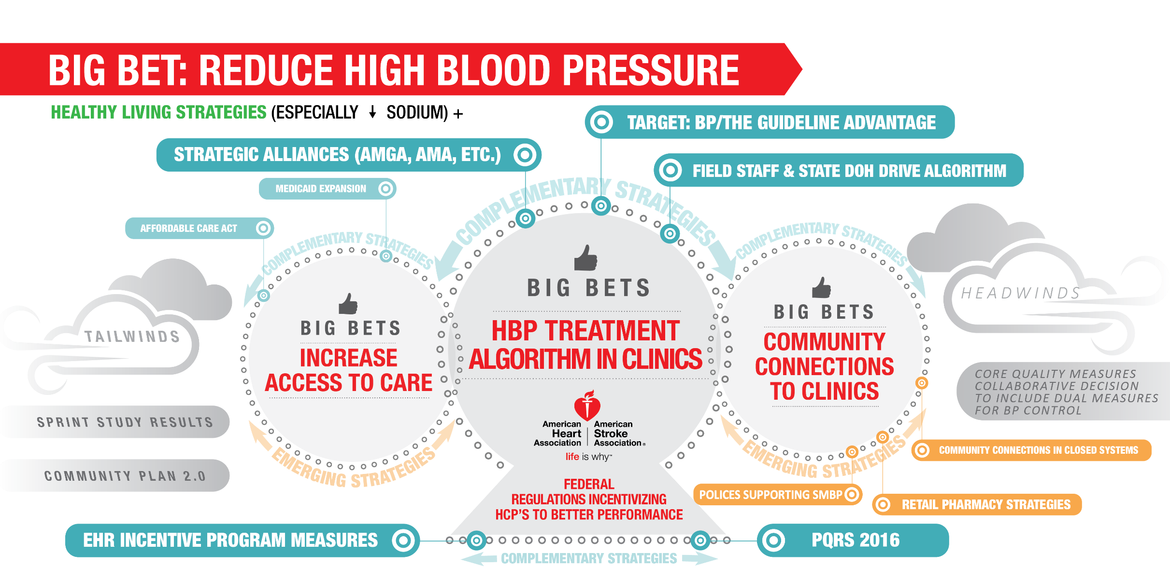

Slide 39
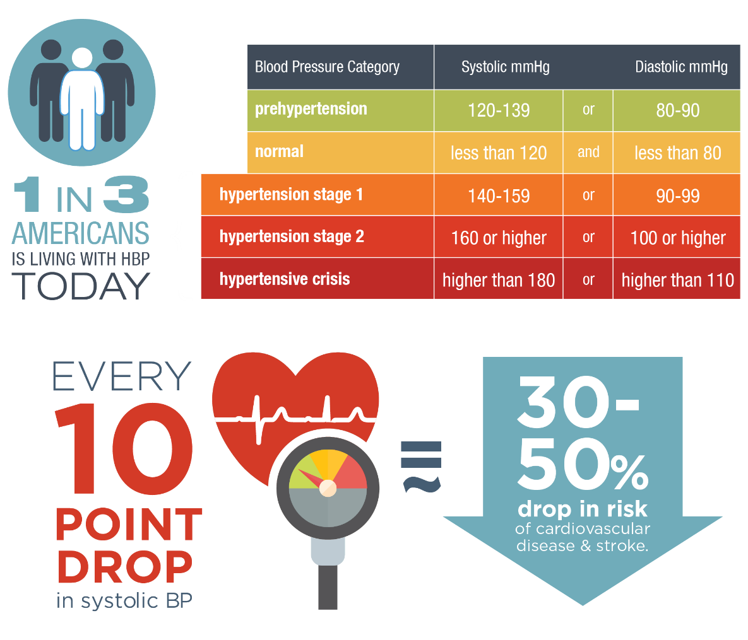
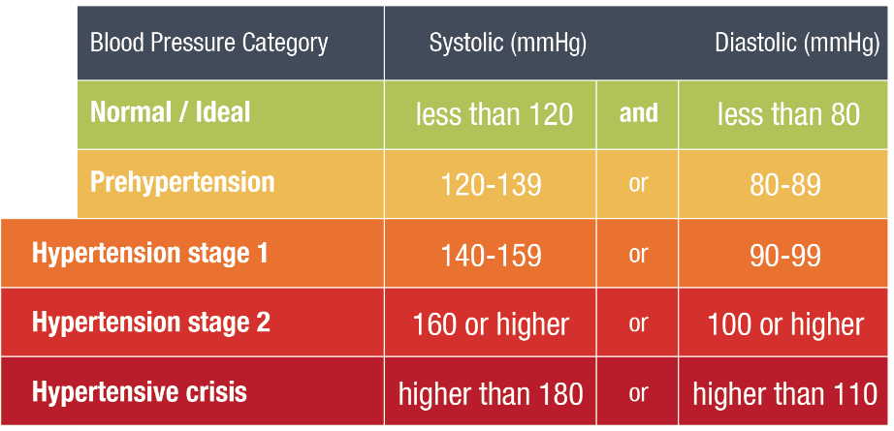
The Urgency
Around
High Blood Pressure Control
80 million adults have HBP
AHA 2015 Statistical Update
Notes:
WHY?
First off, I wanted to share AHA’s road map for achieving our goal of moving millions – 13.4 million – to control by 2020. Recognizing the urgent need to address inadequate control, the American Heart Association (AHA) has made hypertension a primary focus area of its 2014 to 2017 strategic plan, because it seeks to improve the cardiovascular health of all Americans by 20% and reduce the death rate from cardiovascular disease and stroke by 20% by 2020.
Amy Vest suggests we add (particularly when the audience may include anyone not working in medical care):
Today’s BP Control Statistics tell us:
80,000,000 adults have HBP, which –even with advancements we’ve made– is still one in three or 32.6% of the adult population in the US.
Improving these numbers through better BP control directly translates to drop in risk of cardiovascular disease and stroke.

Slide 40
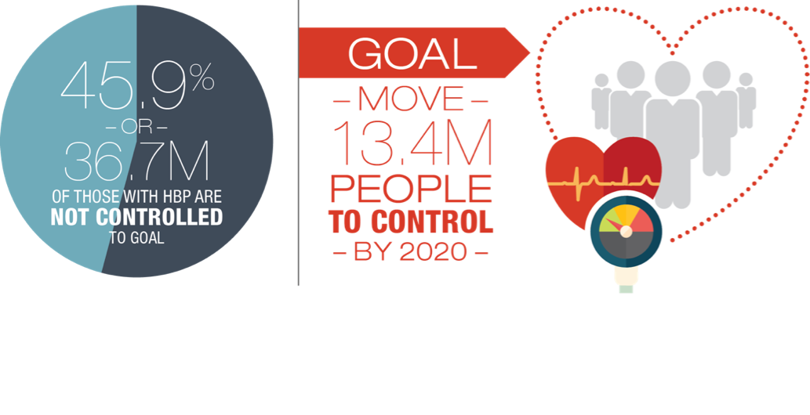
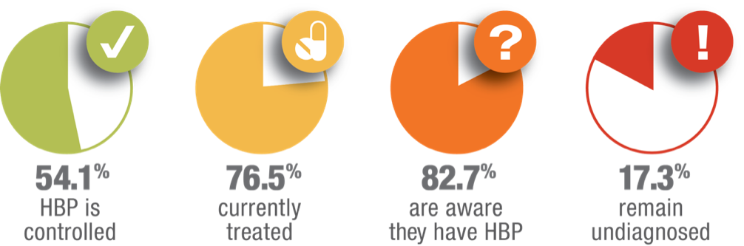
Our
Goal for
Better Control
Notes:
Amy Vest suggests that (especially for any audience which may include laypeople,) we add:
Today’s BP Control Statistics tell us:
Of those 80M with HBP, 45.9% have HBP that is not controlled to goal. That’s 36.7M people. Our goal to improve the health of ALL Americans by 20% by the year 2020 means that we need to move 13.4 M adults to BP control in the next 5 years.

Slide 41
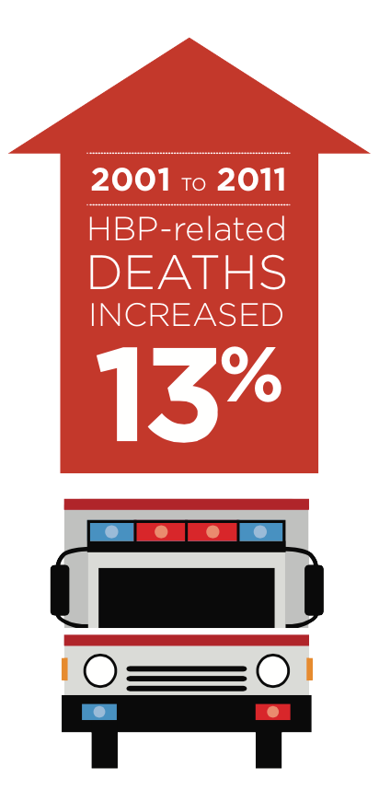
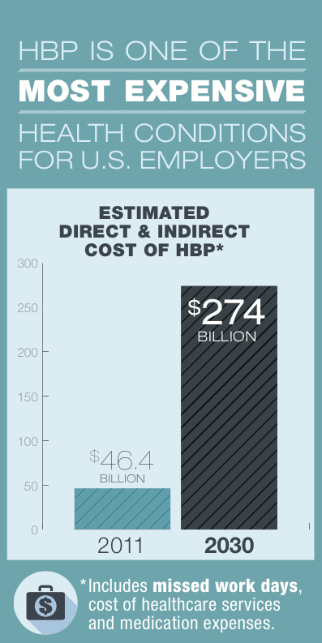
The Urgency
Around
High Blood Pressure Control
AHA 2015 Statistical Update
Notes:
It’s one of the most expensive conditions for U.S. Employers and predictions indicate a greater than 5-fold increase over the next decade.

Slide 42

Check. Change. Control.TM
Notes:
So here’s why we’re here:
To show you what’s exciting about Check. Change. Control.
To define the volunteer mentor’s role
Learn about Heart360 and how you will use it as an engagement and communication tool with program participants
and To highlight your Volunteer Mentor Resources

Slide 43


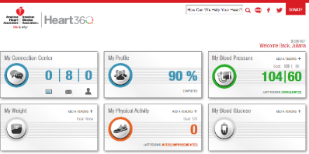
Building a Sustainable HBP Program
Clinical Pharmacists 2008 – 2010 | Community Settings 2010 - 2011 | Enlisting Partners 2012 - Present | Innovation in the Field 2012 - 2013
Remote Monitoring Study via Kaiser Clinical Pharmacists Six month SBP control significantly higher than control group. Suggests healthcare cost saving Attachment 1: Publication in Circulation Attachment 2: Presentation from AHA’s Scientific Sessions 2010 | Check It. Change It. Community-based intervention in Durham County In patients that began the study with a BP of > 150/90, systolic BP decreased by 24.2 mmHg and diastolic BP decreased by 10 mmHg. Attachment 3: Presentation of results: Scientific Sessions 2012 Attachment 4: Publication in Circulation | AHA joined with Million Hearts to host a forum that included partners across industries positioned to impact the issue of HBP Initial meeting was the impetus for the launch of AHA’s HBP Leadership Community based on attendees’ desire to continue the innovation, sharing and exchange of solutions Attachment 5: AHA-Million Hearts HBP Forum Conference Proceedings: This joint meeting was the impetus for the launch of the AHA HBP Leadership Community. | Check It. Change It. set the stage for larger, community-based model run by the AHA focused on high-risk pop. Grants to local market staff designated for rapid development, execution and testing of programs using partners and volunteers. Similar results to Check It. Change It. Lowering BP by 5 mmHG, with more significant drops between 11mmgHG and 26 mHG in high risk groups

Slide 44

Studying Impact: Clinical Pharmacists
Uncontrolled HTN
  Results…
  Overall, patients in the Heart360 HBPM group had a significantly higher rate of BP control (57%) than the usual care group (37%)
  The Heart360 Group also had a significantly greater drop in both systolic and diastolic BP
  For every dollar invested the return is almost 3 dollars
Usual Care
Heart360 HBPM
Initial visit
Initial visit
Referral to PCP
Home BP Monitoring
Six month
follow-up visit
Notes:
Additional notes and background as needed …
Kaiser Home Blood Pressure Monitoring Project
Collaboration between AHA/Kaiser/Microsoft. Some 350 hypertensive enrolled from Kaiser Colorado offices. The goal of this study was to improve hypertension control at Kaiser Colorado. Patients were randomized to a usual care group or a home monitoring group. All patients had their blood pressure measured in the medical office at the start of the six-month study. The usual care group was managed in a typical model that involved checking blood pressure during office visits. The home monitoring group used an at-home blood pressure device that uploaded data to the patient’s account in MS/HV/H360. Kaiser’s clinical pharmacists used a computerized registry to monitor readings and consulted with patients to adjust their antihypertensive medications based on proven protocols. Connected to HealthVault, patients were able to manage their data using Heart360, a free online tool provided by the AHA
At the start of the study, the average systolic blood pressure was 149 mm Hg in the home monitoring group and 145 mm Hg in the usual care group. At six months, patients in the home monitoring group were 50 percent more likely to have their blood pressure controlled to healthy levels compared to the usual care group. Similarly, a significantly greater decrease in systolic blood pressure at six months occurred in the home monitoring group (-21 mm Hg) versus the usual care group (-9 mm Hg).

Slide 45



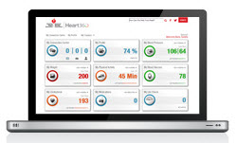
Program Components
Community Partners with Shared Goals to Drive BP Control
Since August, 2012 over 46, 000 participants have enrolled in Heart360
Campaign Results*:
Average drop in Systolic BP:
11.02 mm Hg
Average drop in Diastolic BP:
7.68 mm Hg
Innovative Implementation Across Markets
Health Mentors Encourage Participants to Track Weekly Readings for 4 Months
Heart360 as Central Tool for Participant Engagement and Data Collection
Notes:
As of the end of June 2014, over 20,000 participants and 2,400 volunteer health mentors have participated in the program, which has grown to 175 programs in over 70 markets. The goal initially was to have 30,000 African Americans enrolled in an evidence based blood pressure program by 2014. The innovative approaches and program models have been a rich source of information, which is currently being evaluated. Some highlights of the blood pressure data have been consistent with the Check it, Change it data.
Analysis for 2013 showed BPs trending down among participants with elevated readings at baseline, some sampling of these results include:
Average drop in blood pressure was 5.68/2.87;
If blood pressure was > 140/90, average drop was 17.46/7.96;
If participants uploaded 2 readings for 4 consecutive months, the average drop in BP was 11.2/4.31; and
If participants uploaded 2 readings for 4 consecutive months, and started with a BP > 140/90, their average drop was 27.23/10.52
Analysis for 2014 showed BPs continuing to trend down among participants with elevated readings at baseline:
Average drop in blood pressure was 13.9/9.51;
If blood pressure was > 140/90, average drop was 21.94/12.65;
If participants uploaded 2 readings for 4 consecutive months, the average drop in BP was 14.4/9.14;
If participants uploaded 2 readings for 4 consecutive months, and started with a BP > 140.90, average drop was 26.04/9.09

Slide 46
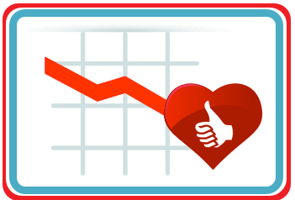
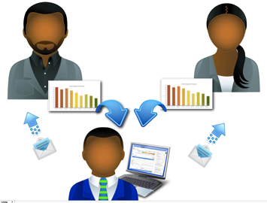

Why it Works: Key Evidence-Based Scientific Principles
Self Monitoring Makes a Difference
Proven track record for taking blood pressure readings
at home or outside of the healthcare provider office setting.
Use of digital self-monitoring and communication tool
(Heart360 which we explain later)
Charting & tracking improves self-management skills related
to blood pressure management
Personal Interaction Makes a Difference
Health mentors can motivate and encourage participants.
Multicultural Program Investments Make a Difference
Hypertension creates a health disparity for African-Americans.
Check. Change. Control.
Notes:
Here’s why Check. Change. Control. is likely to be successful.
Because self-monitoring makes a difference.
Personal interaction makes a difference.
And multicultural program investments make a difference.
These are proven ways to make a positive impact.

Slide 47
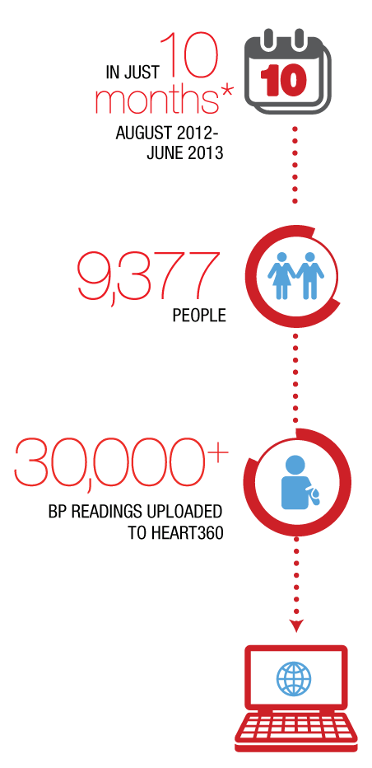
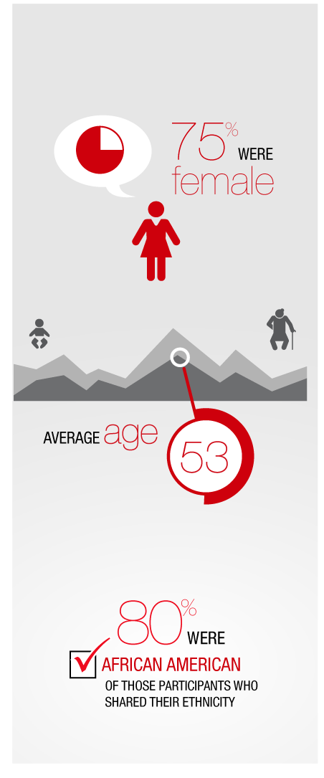
Statistics on the 6-month pilot phase RESULTS
*Approximately
Notes:
Here are some of the results we have tracked so far.
In our pilot phase of 10 monthes, 9377 people participated and uploaded more than 30,000 BP readings to Heart360.
The average age was 53, and 80% were African American, which our targeted population for this pilot.

Slide 48
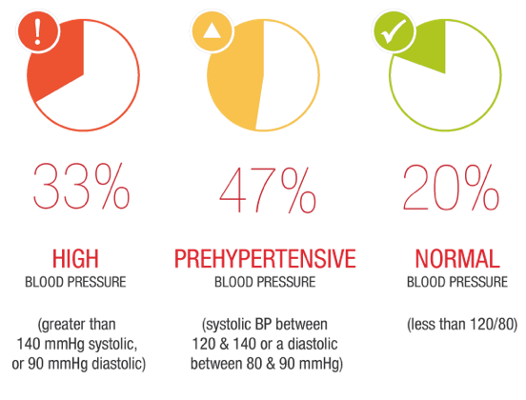
Participants began the program by gathering initial BP numbers.
Notes:
In our sample group, 33% began with HBP, 47% with prehypertension, and 20% began with normal bp.

Slide 49
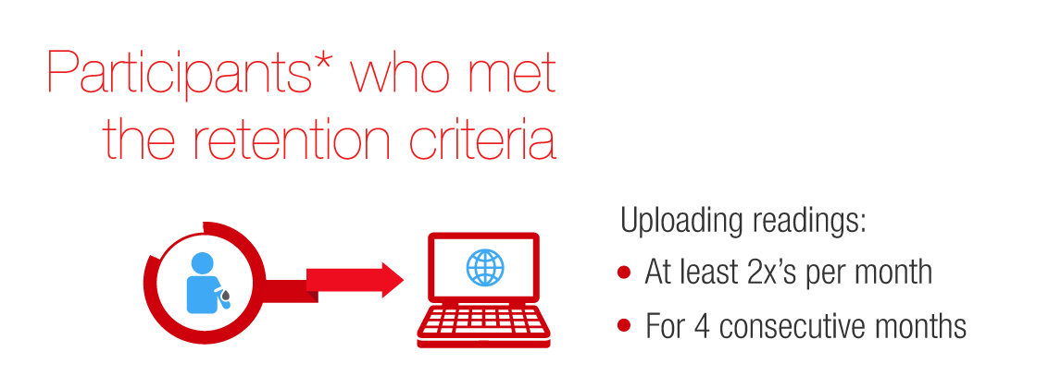
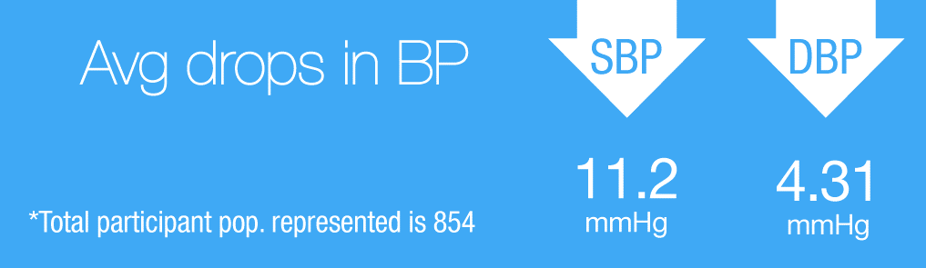

Consistent Measurement
Can Lead To Success
Notes:
The often-repeated maxim holds true, “If you measure it, you’ll likely manage it!”
Of those participants who remained consistent…
It worked!
Participants who simply stayed in the programall four months saw notable drops in the average systolic and diastolic blood pressure numbers.

Slide 50
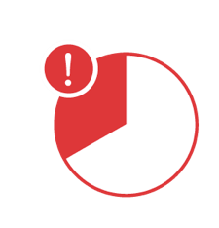
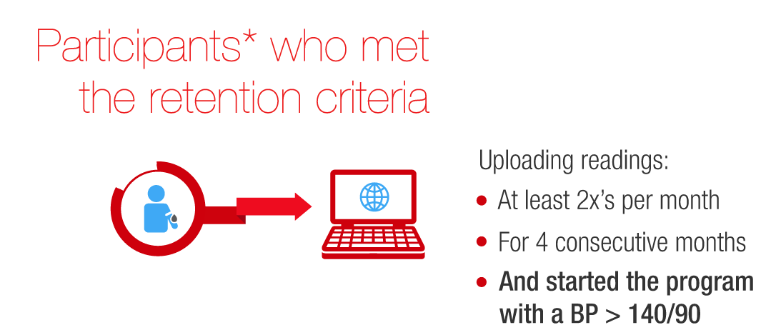
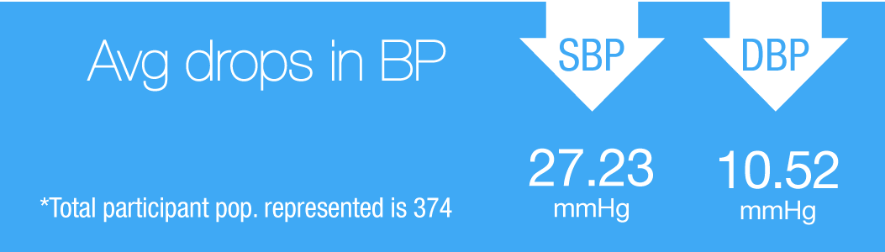
Participants who started with high readings saw the greatest average reduction.
Effective for those with the greatest need.
Notes:
Participants who started with high readings and met retention criteria saw the greatest average reduction in systolic and diastolic BP.

Slide 51
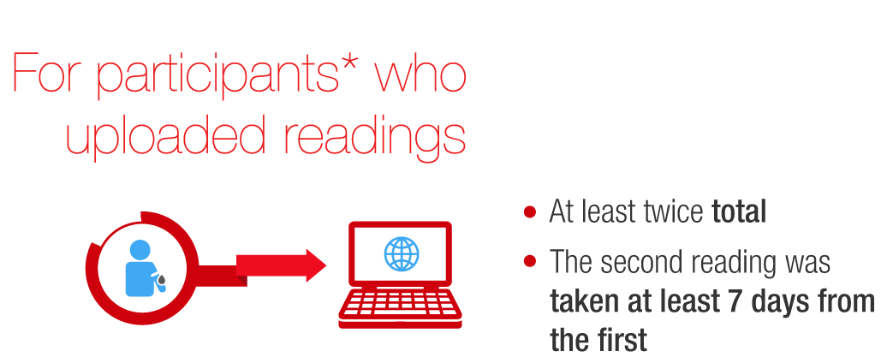
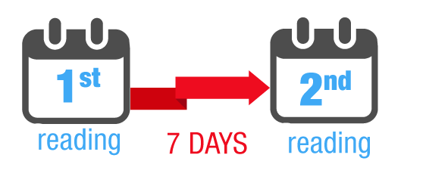
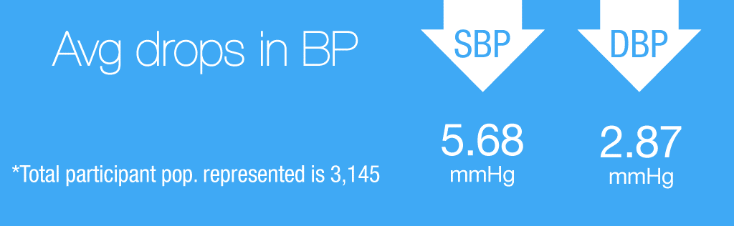
Engagement:
More than a third of all participants entered at least two readings with at least a week’s time separating the two.
Notes:
More than a third of all participants entered at least two readings with at least a week’s time separating the two. This group, although less consistent, also saw reductions in average BP numbers.

Slide 52
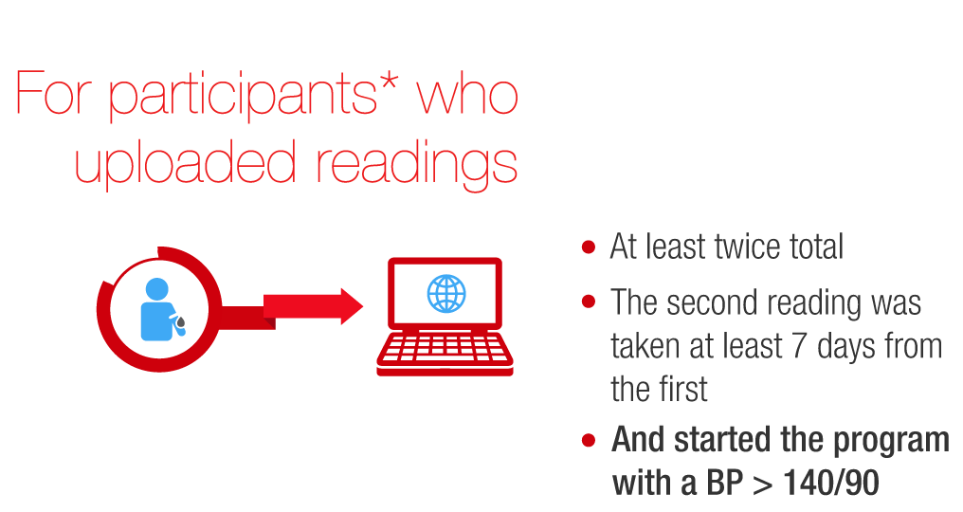
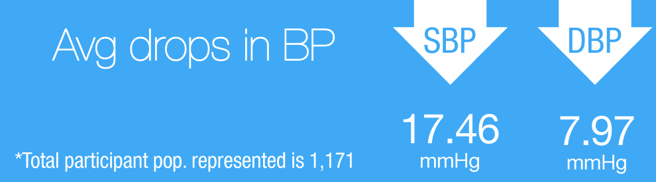
Benefits extend even with partial engagement:
Even those participants who did not meet the full retention criteria saw declines in BP numbers.
Notes:
Even those participants who did not meet the full retention criteria saw declines in BP numbers. This was especially true among those whose baselines indicate HBP.

Slide 53

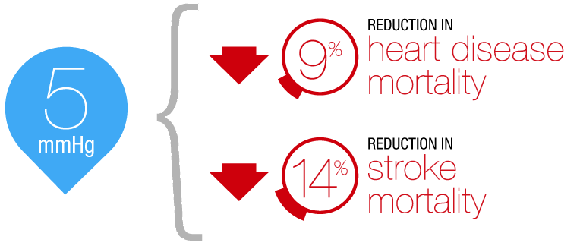
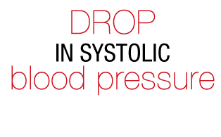
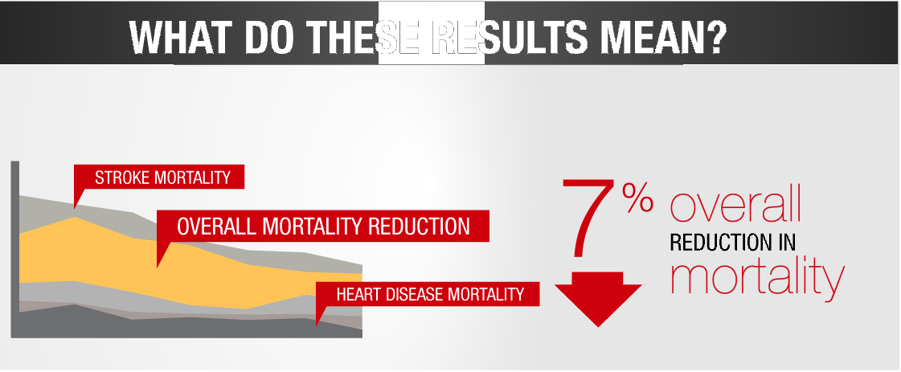
Benefits extend even with partial engagement:
Even those participants who did not meet the full retention criteria saw declines in BP numbers.

Slide 54
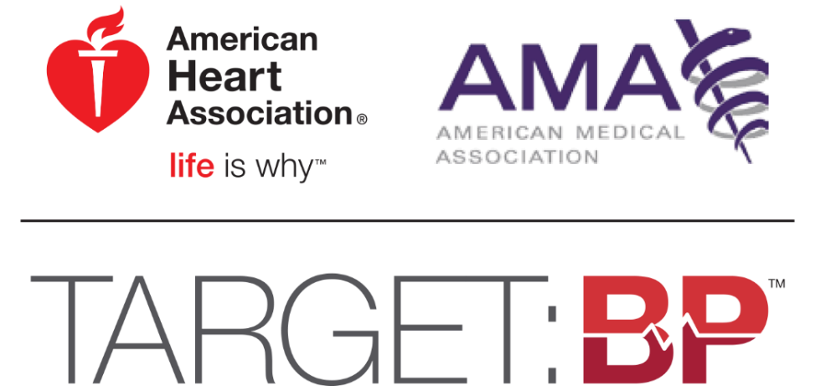
Target: BP is a national movement aimed at improving blood pressure control, to reduce the number of Americans who have heart attacks and strokes. Target: BP provides physician practices and health systems resources and support to achieve a 70% blood pressure control rate with a target of achieving 80% or higher.
Notes:
Mike: Introduction and relevant experience … why the AMA you forged the relationship with AHA. The flexibility of Target: BP to fit the needs of all types of practices and size. Designed to be simple and impactful with our combined resources, etc.

Slide 55
Why launch Target: BP now?
SPrINT study results
Increased access
to care
Policies incentivize HCP’s
to better control
MH
AHA 2020 goals are imminent
Synergizing with Million Hearts program
Notes:
Mike – this is where your practice and experience will start: Eduardo talked stats and why AHA …
You’ll speak to why should a healthcare practice should focus on BP… why is hypertension important as a HCP, etc.
AMA BP focus and how that matches up with the AHA’s focus
Also, several practices are part of MH – please touch on their plans, and how we are working together on Target: BP

Slide 56

What is Target: BP?
✓
A call to action motivating hospitals, medical practices, practitioners and health services organizations to prioritize blood pressure control
Recognition for healthcare providers who attain high levels of blood pressure control in their patient populations, particularly those who achieve 70, 80 or 90 percent control
A source for tools and assets for healthcare providers to use in practice, including the AHA/ACC/CDC Hypertension Treatment Algorithm and the AMA’s M.A.P. Checklist
✓
✓
Notes:
Mike switch slightly from your personal practice to discuss the role of the AMA in hypertension and why they opted to partner with the AHA – expand on each bullet point in regards to the program
This is the only place at this point that I have the recognition program … so you may want to elaborate on recognition program with 1st recognition summer 2017
The last bullet is a transition to your next 2 slides for re(next slide builds out more on the tools and resources)

Slide 57
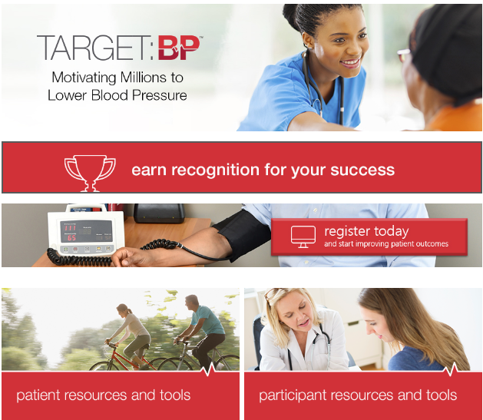
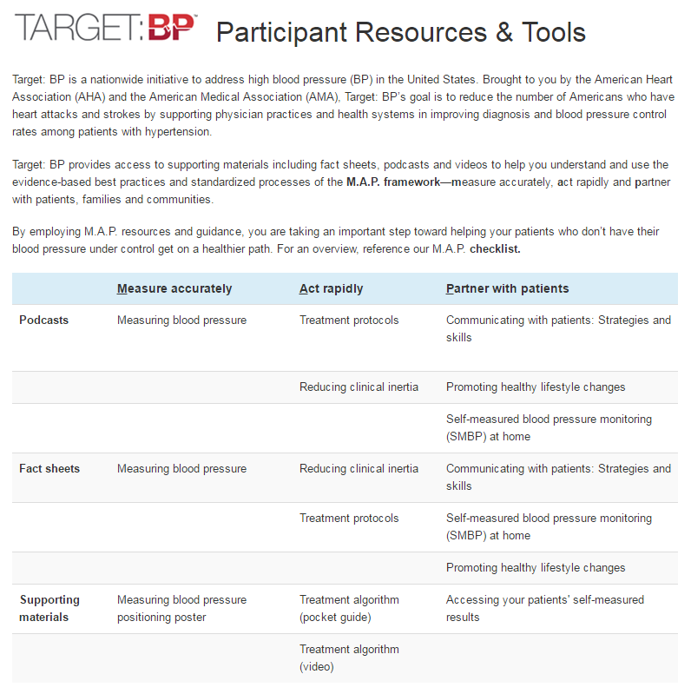
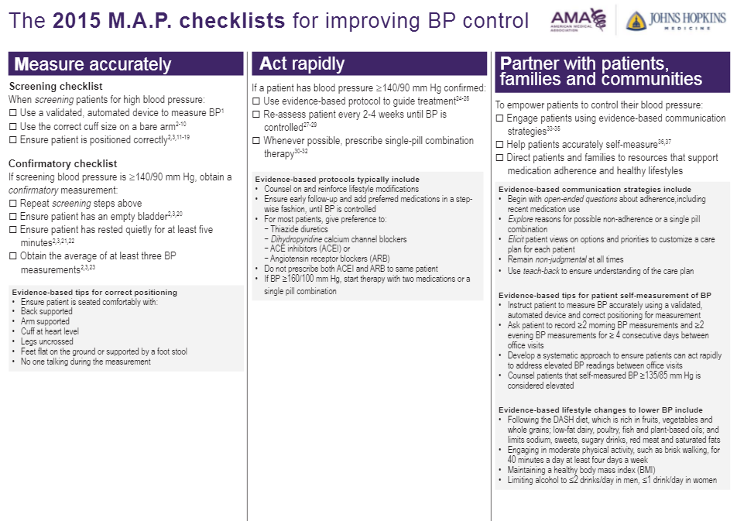
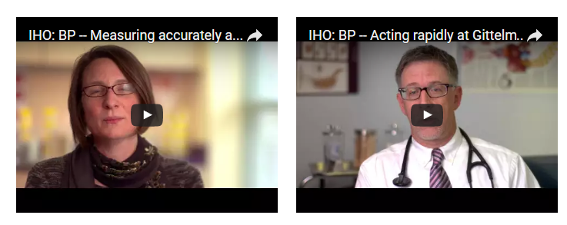
Tools & Resources for Successful Control
Notes:
Mike this is where you’ll start to talk in depth about the participant resources …
They are very interested in the clinical and training materials for staff … so this can have more time than the next slide which is patient
Click 1: Home page and circle will animate around “participant”
Click 2: Tools and Resources page
Click 3: AHA’s algorithm
Click 4: AMA’s MAP checklist
Click 5: AMA’s podcast image
Click 6: Protocols fact sheet

Slide 58
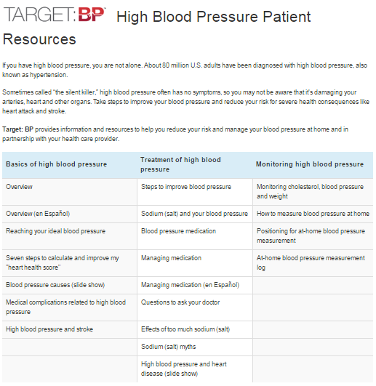
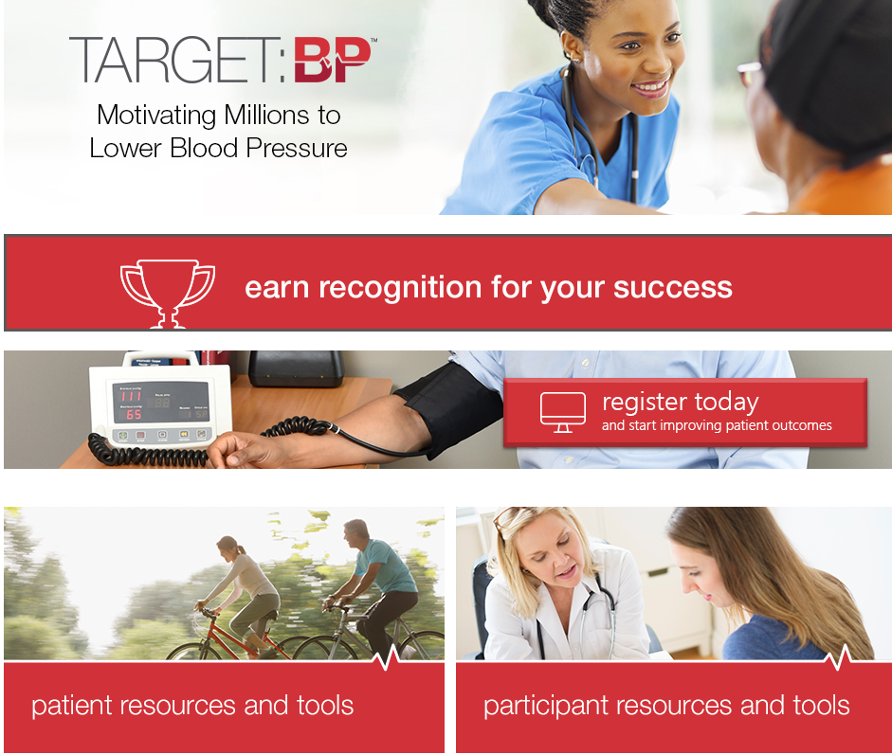
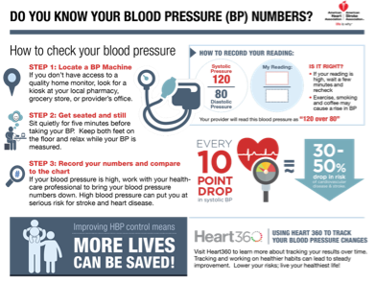
Tools & Resources for Successful Control
Notes:
Patient resources … materials for the HCP to use in educating patients and families as well as staff.
Click 1: Home Page with animated circle around patient
Click 2: HBP patient
Click 3: SMBP for patients
Click 4: Answers by Heart fact sheet

Slide 59



Elements Associated with Effective Adoption of Protocols
Practice Team-Base Care
Make hypertension control a priority.
Fully use the expertise and scope of practice of every member of the health care team.
Include the patient and family as key members of the team.
Learn about community resources and recommend them to patients.
Conduct pre-visit planning to make the most of the care encounter.
Look for opportunities to check in with patients between visits and adjust medication dose as needed.
Notes:
Join us in our mission …. Make hypertension control a priority.
Fully use the expertise and scope of practice of every member of the health care team: physician, advanced practice nurse, physician’s assistant, nurse, hospital and community pharmacist, medical assistant, care coordinator, and others.
Include the patient and family as key members of the team.
Learn about community resources and recommend them to patients.
Conduct pre-visit planning to make the most of the care encounter, such as ensuring that patients bring in their home readings and ask questions or express concerns, including about access to medications and monitoring equipment, adverse effects of medications, and challenges with diet and exercise.
When hypertension is not controlled, look for opportunities to check in with patients between visits and adjust medication dose as needed.

Slide 60

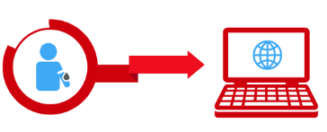


Our Strategic Multi-modal Approach to BP Management
Help providers “do the right thing” within current HC system
Protocol Standardization
Incentives
Increasing role of other Rph and others
Equipping
Providers
Create innovative solutions to empower consumers, strengthen connections to HCPs and create urgency for change
Ubiquitous BP devices
Worksite programs/support for lifestyle change
Technology to connect consumers w/HCPs
Incentives
Motivating & Connecting
Consumers
Provide communities with ownable, sustainable, scalable and customizable programs
Health ambassadors
Pharmacy infrastructure
Apps to integrate consumers w/HCPs
Community health worker curriculum
Activating
Communities
Create accountability at all levels of care
Create accountability at all levels of care
Performance measures
Surveillance system
Enhancing
Systems of Care
Notes:
Our plan is comprehensive and seeks to attack the issue of hypertension from multiple angles of influence … beginning with:
Equipping Providers – much of this work is around the standardization of protocols which we will spend our time talking about today.
We also are working through direct to consumer channels to motivate individuals to take hypertension seriously and connect them with resources and tools to help develop habits like self-monitoring and make important lifestyle changes like the decrease of sodium intake.
In communities, we are seeking to reach underserved populations working with stakeholders at churches, community centers, clinics and housing to support individuals in making the changes they need to make to get their blood pressure under control.
And finally, looking at the system of care, again something we will talk more about today, ensuring systems are set-up to make hypertension management targeted and easier for healthcare providers.

Slide 61
Partners, Programs and Persons That Align,
Ways to Work Together
and
Next Interactions

Slide 62
Wrap-Up/Adjourn

Slide 63
Thank you for your participation!

