Slide 1

Advancing Million Hearts®:
AHA and State Heart Disease and Stroke
Prevention Programs Working Together in Idaho
July 27, 2016
10:00 AM to 3:00 PM MT
JRW Building, East Conference Room
700 West State Street
Boise, ID 83702

Slide 2
Welcome & Overview of the Day
John Clymer, Executive Director
National Forum for Heart Disease and Stroke Prevention
Co-Chair, Million Hearts® Collaboration

Slide 3
Introductions
What excites you about your role in heart disease and stroke prevention?

Slide 4
The Million Hearts® Initiative
Robin Rinker, MPH, CHES
Health Communication Specialist

Slide 5
Million Hearts®
Goal: Prevent 1 million heart attacks
and strokes by 2017
National initiative co-led by CDC and CMS in partnership with federal, state, and private sectors
To address the causes of 1.5M events and 800K deaths a year, $316.6 B in annual health care costs and lost productivity and major disparities in outcomes
5
Notes:
Million Hearts® is a national initiative, launched in January 2012 by the U.S. Department of Health and Human Services.
It is co-led by CDC and CMS and focuses on aligning and brining together the efforts of federal agencies, states, regions, communities and individuals on a common goal—preventing one million heart attacks and strokes by 2017
This goal is audacious and achievable only with the collective efforts of each of us as individuals and as members and leaders of our communities, workplaces, and organizations.
HHS asked CDC and CMS to bring their collective strengths to lead this initiative, ensuring the coordination of public health, clinical care and policy approaches to this complex problem.
We are delighted by the robust participation of private sector partners from states to health professional societies, health advocacy groups, and faith based organizations, and commercial payers to name a few.

Slide 6

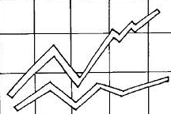
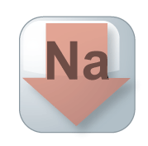



Key Components of Million Hearts®
Keeping Us Healthy
Changing the environment
Excelling in the ABCS
Optimizing care
Health Disparities
Focus on the ABCS
Health tools
and technology
Innovations in care delivery
TRANS
FAT
Glantz. Prev Med. 2008; 47(4): 452-3.
How Tobacco Smoke Causes Disease: A Report of the Surgeon General,2010.
Notes:
In order to prevent a million heart attack and strokes, we knew there was work to be done in changing the environments in which we live, work and play and in achieving excellence in our healthcare.
This slide outlines the key components of this needed work.:
By increasing smoke free environments, decreasing sodium in the food supply, and eliminating trans fat, we would change our environment in ways that keep people healthier and less likely to need health care. Were you aware that when communities go smoke-free, there is an immediate decrease in the number of hearts attacks seen in those communities? (“50 Years of Progress: A Report of the Surgeon General, 2014 page 442)
In addition to changes to our environment, we also need to help patients, healthcare professionals and systems achieve excellence in the care delivered. In the clinical arena, we can reduce heart attacks and strokes by:
Focusing the attention of patients, healthcare professionals and the systems in which they work, on the ABCS (Aspirin when appropriate, Blood pressure control, Cholesterol management, Smoking cessation);
Harnessing the power of health information technology to improve health outcomes;
Developing, testing, and deploying new models of care that recognize and reward outcomes and value.
[Click again and the Health Disparities box will pop up.]
As a nation, we can and must do better. For certain segments of our nation, the burden is even greater. As we work on changing the environment and optimizing care, we need to make sure we are addressing the needs of those who are disproportionately affected by cardiovascular disease.

Slide 7
Getting to a Million by 2017:
Public Health Targets
Intervention | Pre-Initiative Estimate 2009-10 | 2017 Target
Smoking prevalence* | 26% | 24%
Sodium reduction | 3580 mg/day | 2900 mg/day
Trans fat reduction | 0.6% of calories | 0% of calories
* Includes all forms of combustible tobacco – cigarettes, pipes, and cigars
National Survey on Drug Use and Health, National Health and Nutrition Examination Survey

Slide 8
Getting to a Million by 2017:
Targets for the ABCS
Intervention | Pre-Initiative Estimate 2009-2010 | 2017 Population-wide Goal | 2017 Clinical Target
Aspirin when appropriate | 54% | 65% | 70%
Blood pressure control | 52% | 65% | 70%
Cholesterol management | 33% | 65% | 70%
Smoking cessation | 22% | 65% | 70%
National Ambulatory Medical Care Survey, National Health and Nutrition Examination Survey
8

Slide 9
Million Hearts® Accomplishments*
Draft Voluntary Guidance to Industry Released June 1, 2016
Notes:
With support from national, state, and local partners, we have seen many accomplishments since Million Hearts® began.
This slide highlights a select set of notable ones, keeping in mind that there are many more across the country.
Since Million Hearts® began we have seen 4 million fewer cigarette smokers
More than 2 billion meals/year will have reduced sodium.
The FDA released draft voluntary guidance to industry on June 1 for public comment.
We consider the goal to eliminate artificial trans fat as being accomplished when FDA issued the final determination on artificial trans fat.

Slide 10
Million Hearts® Accomplishments
Notes:
Thanks to the work of Million Hearts® partners focusing on the ABCS, millions of American are now covered by health care systems that are recognizing and rewarding performance on the ABCS.
Over half a million patients have been identified as potentially having hypertension through the use of health IT tools.
And millions of dollars in public and private funds have been leveraged to focus on improving the ABCS.

Slide 11
Million Hearts Progress to Date
Engagement and activation
Clinical Quality Measure alignment
Understand what works, where, and why
Resources that help
Extraordinary support for prevention
Notes:
Million Hearts® has seen much engagement and activation from a variety of organizations.
Over 125 organizations have partnered with Million Hearts® and have committed to taking actions to support cardiovascular disease prevention
There are cvd prevention activities happening throughout all 50 states, DC and even the territories.
And over 325 faith-based congregations have committed to raise awareness about risks for heart disease and stroke and educate individual about prevention
To reduce the reporting burden on professionals and focus quality efforts to achieve the greatest impact on outcomes, Million Hearts® staff worked with public and private partners to align and embed a focused set of evidence-based clinical quality measures into major quality reporting initiatives. These measures represent key outcomes related to the ABCS.
Clinicians can find a list of the quality reporting initiatives that have measures aligned with Million Hearts® on the Million Hearts® website.
New and already established projects have been aligned with Million Hearts® to help us better understand what works, where, and why.
Examples of these include a the American Medical Group Foundation’s Measure Up. Pressure down. Campaign that challenged and helped medical groups achieve higher rates of hypertension control. Another is a CDC-funded project with the Association of State and Territorial Health Officials that funds states to focuses on rapid improvement in identifying or controlling those with hypertension by bringing together partners across sectors including clinical, community, and public health.
Million Hearts has brought together key subject matter experts to develop resources to improve cardiovascular health including a Health Eating Center, action guides for clinicians, public health practitioners and employers, and protocols.
We have also seen extraordinary support for Million Hearts® across many federal programs.

Slide 12
Million Hearts®
Hypertension Control Champions
59 Champions
Representing
Solo to 70,000 Clinicians
Serving over 13 million people
>70% Control Rate
Practices and systems achieved control rates > 70%
Champions used evidence-based strategies
  Hypertension treatment protocols
  Self-measured blood pressure monitoring
  Frequent check-in’s
  Registries and proactive outreach
  Team-based care.
Next Million Hearts® Hypertension Control Challenge planned for launch in Feb 2017
Notes:
Million Hearts® has an annual Hypertension Control Challenge that identifies and recognizes health care professionals, practices, and systems that achieved blood pressure control for ≥70% of their patients.
The goals of the challenge are to:
Document and bring attention to standard and innovative system-level processes or approaches used by high performers
Improve understanding of successful implementation strategies at the health system level
Motivate individual practices to strengthen their hypertension control efforts.
To enter the Challenge, participants complete the nomination form which includes information such as on the size of the population served, the calculated HTN prevalence and control rates, and information about what has led to the current control rate.
To date, Million Hearts® has recognized 59 Hypertension Control Champions. Together these Champions include approximately 70,000 Clinicians serving over 13 million people through a variety of evidence-based strategies such as HTN treatment protocols,
The next Challenge is planned to launch in February 2017.

Slide 13
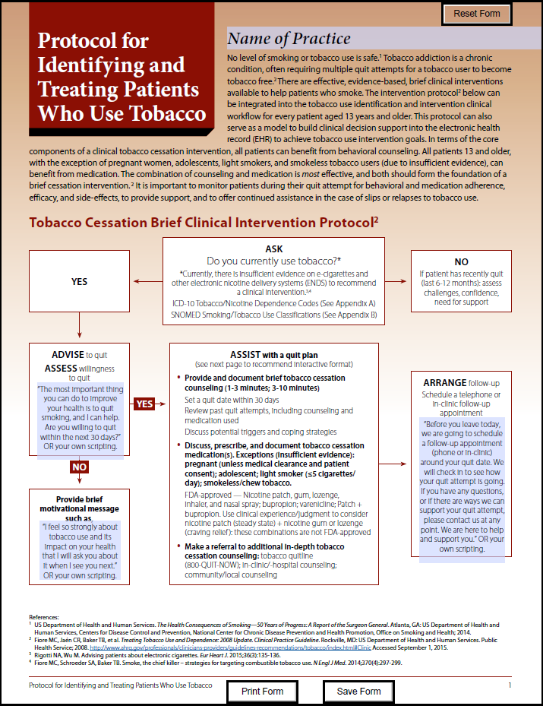
Standardizing Treatment through Protocols
Hypertension Treatment Protocol
  Use is on the Rise
  All Indian Health Service clinical settings
  Many Federally Qualified Health Centers
  Practices supported by CMS’ Quality Improvement Organizations
Tobacco Treatment Protocol
  Released a Tobacco Treatment Protocol in May
  Customizable templates
  Implementation guidance
    - coming in July
Notes:
Practices supported by CMS’ Quality Improvement Organizations
Q3 2015: 766 of 2911 (26%) were using a protocol
Q4 2015: 2399 of 7,058 (34%) were using a protocol
Q2 2016: over 1.5M patients are receiving protocol-driven care
Released a Tobacco Treatment protocol in May
Like the HTN treatment protocol, the tobacco protocol has customizable templates so practices can best customize to their needs.
- We are planning on releasing a guide to help with implementation in July.

Slide 14
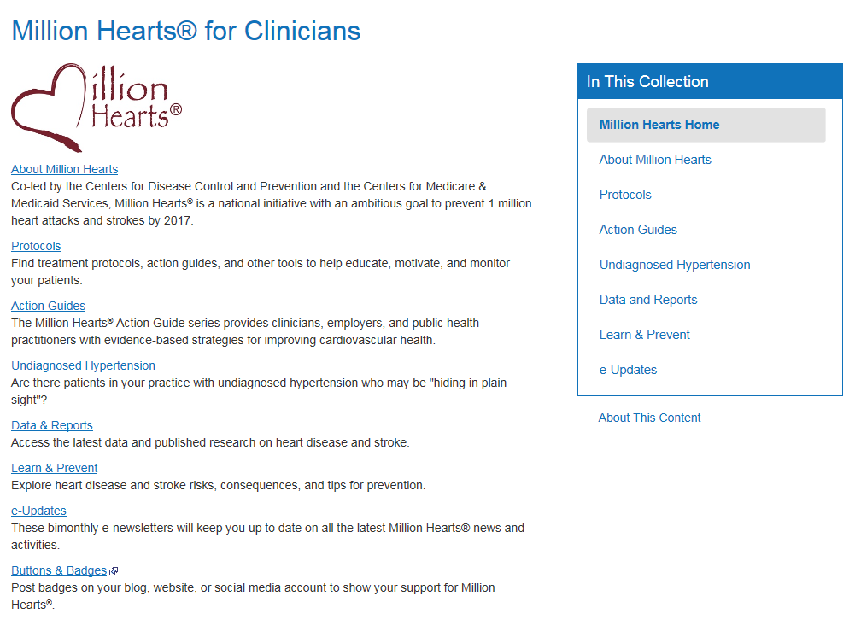
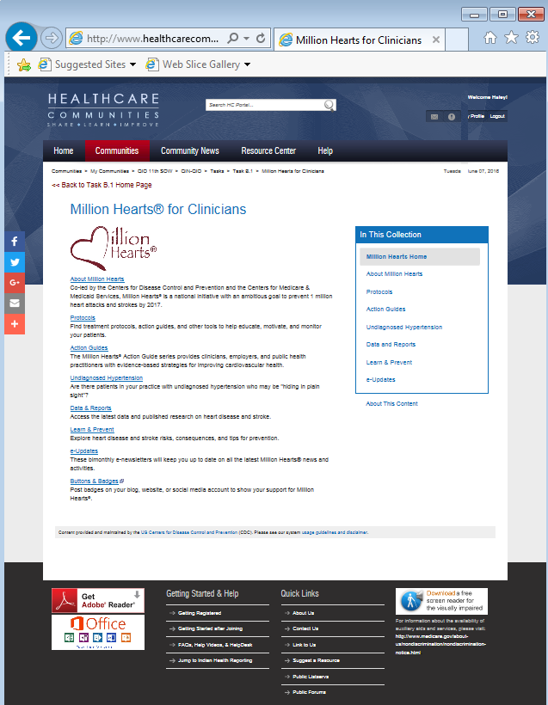
Million Hearts® Microsite for Clinicians
Syndicated for your website audience
Customized for your site’s size and color pallet
Brand it with your logo
Content is continuously maintained by CDC
The microsite and embed code will be available at https://tools.cdc.gov/medialibrary/index.aspx#/results

Slide 15
  What Must Happen To Prevent a Million?
Year-round media campaigns; pricing interventions
Targeted outreach to drive uptake of covered benefits
Systematic delivery of cessation services through use of cessation protocols, referrals to quit lines, and training of clinical staff
Widespread adoption of smoke-free space policies
Awareness of risks of second-hand smoke and the health benefits of smoke-free environments
Reduce Smoking
6.3M fewer smokers
Detection of those with undiagnosed hypertension
Systematic use of treatment protocols & other select QI tools
Practice of self-measured BP monitoring with clinical support
Recognition of high performers; dissemination of best practices
Connection of clinical & community resources to benefit people with HTN
Enhanced medication adherence
Intense focus on those with high burden and at high risk
Control Hypertension
10M more patients
Adoption of Healthy Food Service Guidelines
Voluntary sodium reduction and expansion of choices by food industry
Recognition of high performers and dissemination of best practices
Clear communication of the evidence supporting the health benefits of population-level sodium reduction
Decrease Sodium Intake
20% reduction
Events will also be prevented by improving aspirin use, cholesterol management,
and utilization of cardiac rehab, and by eliminating artificial trans-fat consumption
Notes:
Evidence-based strategies to prevent a million: This is how Million Hearts makes the biggest impact.
When organizations are considering how to align their efforts with Million Hearts, the strategies on the right are an excellent place to start.

Slide 16
Focus of 2016
Smoking cessation
  Facilitate implementation of tobacco cessation protocols
  Promote smoke-free spaces
Hypertension control
  Facilitate use of self-measured BP monitoring, treatment protocols, and processes to find the undiagnosed
  Share best practices by promoting action guides that identify and control hypertension
Sodium reduction
  Advance adoption of procurement guidelines
  Disseminate healthy eating resources
Notes:
That leads us to what we want to focus on in 2016, in order to Finish Strong
Here are some action steps that organizations can consider to help meet the Million Hearts® goal of preventing heart attacks and strokes.

Slide 17
Focus of 2016
Cholesterol management
  Implement statin measure across clinical settings
  Support partner actions currently underway
Cardiac rehab
  Facilitate collective actions to increase referral and participation
Embed ABCS measures in value-based models
Capture and tell the story of your success
Recognize high performers & share best practices
  Learn about the successes of the Hypertension Control Champions and share their lessons learned.
Notes:
Cardiac Rehab
Facilitate collective actions to increase referral and participation in cardiac rehab programs.
A Million Hearts® Cardiac Rehab Collaborative (CRC) came together in February and meets quarterly to share and accelerate progress in this area.
[NOTE TO PRESENTER: The CRC welcomes those that are ready to take action to join these meetings. To learn more, send questions to millionhearts@cms.hhs.com]

Slide 18
3 Phase Framework for Million Hearts
January 2016-July 2017
Primary Activities, Timelines, and Deliverables
Finishing Strong
January to December 2016
Plant and push key actions
Measure and report impact
Collect and tell stories
Celebrate
Transition Zone
March 2016-July 2017
Gather input from stakeholders
Incorporate findings of evaluation and modeling
Set framework, metrics, budget
Engage partners, leadership
Disseminate final report
Million Hearts 2.0
January - July 2017 Launch
Issue new aim and targets
Ignite novel collaborations
Gather powerful commitments
Serially launch at events in 1st 6 months
Cogent Final Report
Refreshed, Bold, Engaging Initiative
Bigger, Deeper Impact
Notes:
Finishing Strong: Million Hearts wants to show impact and results as well as; acknowledgment of partners and participants; and summary of lessons learned.
Transition Zone March 2016-July 2017: During this planning period Million Hearts® will seek and incorporate input from others so the result is an initiative that resonates with those who can implement it.
Bigger, Deeper Impact.: By July 2017, Million Hearts® is working to launch a program that builds on the strengths of the first 5 year effort in order to prevent CVD and improve CV health.

Slide 19
Million Hearts® Resources
Hypertension Control: Change Package for Clinician
Hypertension Treatment Protocols
Self-Measured Blood Pressure Monitoring: Action Steps for Public Health Practitioners
  Cardiovascular Health: Action Steps for Employers
  100 Congregations for Million Hearts
Million Hearts Healthy Eating & Lifestyle Resource Center
  Million Hearts® E-update
Visit www.millionhearts.hhs.gov to find more resources
Notes:
Handout in today’s packet captures some of these resources: I particularly want to highlight these….

Slide 20




Subscribe—and Contribute to the E-Update
Commit to key action steps
Work together to prevent heart attacks and strokes
Thank You
Notes:
Spread the word, share with your networks, and check out our resources and tools on our website.
For those that organizations that aren’t clinically focused, look at goals and think about what you can do within the scope of your work/organization to promote these action steps
Stay tuned for Million Hearts 2.0. If you have meetings or events planned for the first 6 months of 2017 and would like to feature a Million Hearts 2.0 kick-off, please let us know

Slide 21
Q & A
Group Interaction
How does your work align
with Million Hearts®?

Slide 22

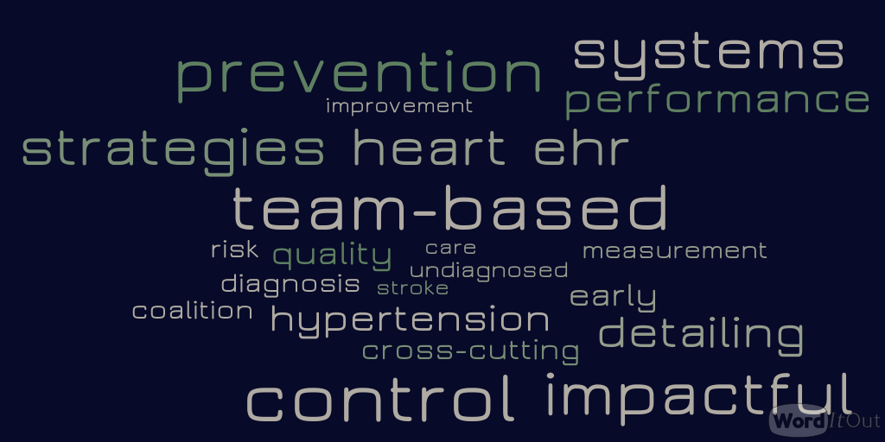
Health Systems
Health Systems

Slide 23
Idaho Heart Disease and Stroke Prevention Program
State Public Health Actions to Prevent and Control Diabetes, Heart Disease, and Obesity and Associated Risk Factors and Promote School Health (CDC-RFA-DP13-1305)
  Improved delivery and use of quality clinical and other health services aimed at preventing and managing high blood pressure
  Increase links between community and clinical organizations to support prevention, self-management and control of high blood pressure, diabetes and obesity

Slide 24
Advancing Million Hearts
Effective use of HIT to improve performance
Team-based care
Identifying undiagnosed hypertension
Address uncontrolled hypertension

Slide 25
1305 Activities
Health Systems Funding
7 Public Health Districts
  Academic Detailing
    MH HIPS, Hypertension Control Change Package, Idaho Blood Pressure Toolkit
  Hypertension and Diabetes Coalition
Evidence-based training and resources

Slide 26
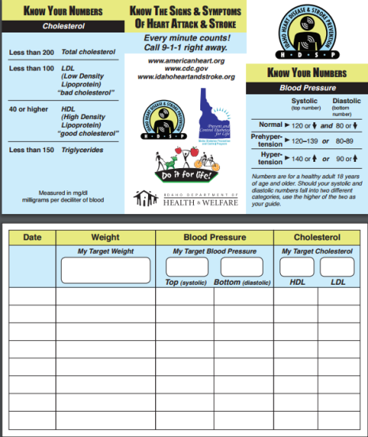
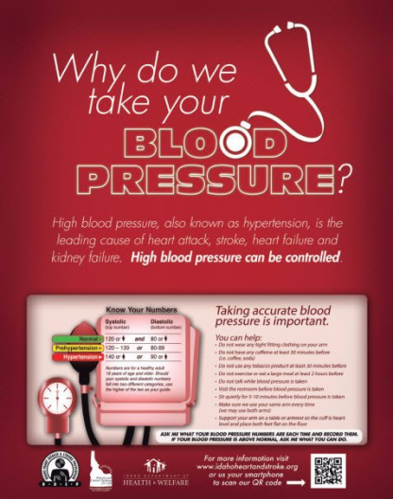
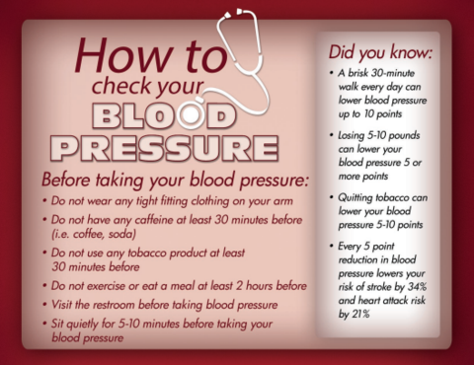
healthtools.dhw.idaho.gov

Slide 27
Effective use of HIT to Improve performance
Health System Example
  A 10% reduction of diabetic patients with a BP >140/90 occurred between Q1 & Q2.
    EHR and HIT optimization
    Quality improvement processes
    Team-based care
    Accurate blood pressure measurements

Slide 28
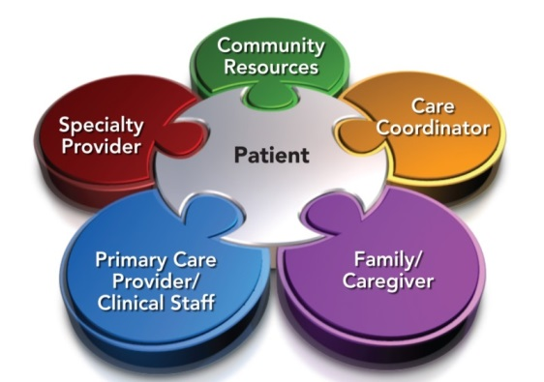
Team-based care
Health System Example
Community Health Worker Promotion
Next Steps – Pharmacists’ roles
  Collaborative Practice Agreements
  Pharmacy assessment

Slide 29
Undiagnosed Hypertension
Health System Example
  Identify potential hypertension patients seen in Urgent Care that do not have a PCP at clinic
    Data refinement
    Reporting/Monitoring
    Quality improvement processes
    Team-based care
    Follow-up processes

Slide 30
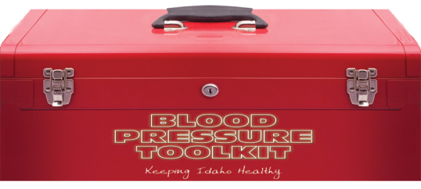
Addressing Uncontrolled Hypertension
Promote accurate blood pressure measurement
Self-monitored blood pressure tied with clinical support
Academic Detailing

Slide 31
Contact Information
Diabetes, Heart Disease and Stroke Programs
Nicole Runner, CHES
Health Program Manager
Office: 208-334-0648 | Cell: 208-949-1617
Email: RunnerN@dhw.idaho.gov
Ashley Rundle, CHES
Health Program Specialist
Phone: 208-334-4928 | Cell: 208-972-7945
Email: RundleA@dhw.idaho.gov
Nicole Stickney, MHS
Health Program Specialist
Office: 208-334-5610 | Cell: 208-859-0743
Email: StickneN@dhw.idaho.gov

Slide 32
Q & A
Group Interaction

Slide 33
Idaho + Million Hearts =
Healthier People Everywhere
Janet Wright MD FACC
Executive Director, Million Hearts
July 26, 2016

Slide 34
Presentation Outline
Progress Report
What Works to Control Hypertension
Resources to Help You Succeed Wildly
A Look Ahead

Slide 35
Million Hearts®
Goal: Prevent 1 million heart attacks
and strokes by 2017
National initiative co-led by CDC and CMS in partnership with federal, state, and private sectors
To address the causes of 1.5M events and 800K deaths a year, $312.6 B in annual health care costs and lost productivity and major disparities in outcomes
35

Slide 36
Key Components of Million Hearts®
Keeping Us Healthy
Changing the environment
Health Disparities
Excelling in the ABCS
Optimizing care
Aspirin when appropriate
Blood pressure control
Cholesterol management
Smoking cessation
Focus on the ABCS
Health information technology
Innovations in care delivery
TRANS
FAT

Slide 37
Getting to a Million by 2017:
Public Health Targets
Intervention | Pre-Initiative Estimate 2009-10 | 2017 Target
Smoking prevalence* | 26% | 24%
Sodium reduction | 3580 mg/day | 2900 mg/day
Trans fat reduction | 0.6% of calories | 0% of calories
* Includes all forms of combustible tobacco – cigarettes, pipes, and cigars
National Survey on Drug Use and Health, National Health and Nutrition Examination Survey

Slide 38
Getting to a Million by 2017:
Targets for the ABCS
Intervention | Pre-Initiative Estimate 2009-2010 | 2017 Population-wide Goal | 2017 Clinical Target
Aspirin when appropriate | 54% | 65% | 70%
Blood pressure control | 52% | 65% | 70%
Cholesterol management | 33% | 65% | 70%
Smoking cessation | 22% | 65% | 70%
National Ambulatory Medical Care Survey, National Health and Nutrition Examination Survey
38

Slide 39
Progress Report at Year 4.5

Slide 40
Million Hearts® Accomplishments*
Voluntary Sodium Guidance to Industry
Issued June 1st, 2016

Slide 41
Million Hearts® Accomplishments

Slide 42
Million Hearts Progress to Date
125 partners, all 50 states, coalitions,
>65K subscribers, 335 Congregations
Engagement and activation
Clinical Quality Measure alignment
Understand what works, where, and why
Resources that help
Focus on what makes a difference
Champions
Guides, Healthy Eating Center, CQM Dashboard, Protocols, Funding
6.3M smokers quit
10M people with hypertension achieve control
20% less sodium each day
Focus on those with the greatest burden and at the greatest risk
Notes:
The Context for Protocols: Million Hearts Progress to Date
At the end of year three, progress has been achieved in five areas. First, at least 110 federal, state, and private sector partners have engaged in clinical work to improve the ABCS or public health action to reduce sodium intake, tobacco use and smoke exposure, and the consumption of trans-fats. Second, important progress has been made in quality measure alignment across the Department through the adoption of a single blood pressure control measure and its use in a variety of incentive programs. Third, the recognition of high performers has identified best practices across diverse settings and patient populations and, in particular, it has highlighted how standardized approaches to care contribute to better outcomes. Fourth, practical resources have been developed and disseminated to help improve cardiovascular care and health. These range from guides for clinicians, public health practitioners, employers, and individuals to a Clinical Quality Measure Dashboard that displays ABCS performance by date and geography, the Healthy Eating and Lifestyle Resource Center, and a suite of hypertension treatment protocols with implementation guidance and supporting literature. Finally, while maintaining the commitment to progress in aspirin, cholesterol, and trans-fat, we have narrowed our focus to reducing the number of smokers by 6.3 million, controlling blood pressure in 10 million more people with hypertension, and lowering Americans’ daily sodium intake by 20%.

Slide 43

Getting to a Million by 2017:
Targets for the ABCS
Intervention | Pre-Initiative Estimate 2009-2010 | 2017 Population-wide Goal | 2017 Clinical Target
Aspirin when appropriate | 54% | 65% | 70%
Blood pressure control | 52% | 65% | 70%
Cholesterol management | 33% | 65% | 70%
Smoking cessation | 22% | 65% | 70%
National Ambulatory Medical Care Survey, National Health and Nutrition Examination Survey
43

Slide 44
FACTS

Slide 45
Only Half of Americans with Hypertension Have It Under Control
71 MILLION
ADULTS WITH HYPERTENSION (31%)
(35 M)
SOURCE: National Health and Nutrition Examination Survey 2011-2012.
Notes:
The 52% represents NHANES 2011-2012 data for blood pressure control.

Slide 46
Awareness and Treatment among Adults with Uncontrolled Hypertension
35 MILLION
ADULTS WITH UNCONTROLLED HYPERTENSION
SOURCE: National Health and Nutrition Examination Survey 2011-2012.

Slide 47
Most People with Uncontrolled HTN are Insured and Seen Regularly
89%
85%
74%
Yes No
Usual Source of Care
Yes No
Health Insurance
≥2 1 None
# Times Received Care in Past Year
Source: National Health and Nutrition Examination Survey 2009-2012.
Notes:
47

Slide 48
FIND
People with Hypertension

Slide 49
Find the Uncontrolled
Make it a practice—and community--priority
Equip every team member with the right skills
Query the EHR
Proactively reach out to these patients & families
Track and share progress across the team

Slide 50
Million Hearts EHR Optimization Guides
Step-by-step instructions for health care professionals to use their EHRs to find and improve data on CV measures
Guides for Allscripts, Cerner, NextGen are at
https://www.healthit.gov/providers-professionals/million-hearts
ONC welcomes all EHR vendors’ collaboration. Submit vendor suggestions to MillionHeartsONC@hhs.gov
Questions? Contact Hibah.Qudsi@hhs.gov

Slide 51
Find the Undiagnosed

Slide 52
Compare to local, state, or national prevalence data
Establish clinical criteria for potential undiagnosed HTN
Search EHR data for patients that meet clinical criteria
Implement a plan for addressing the identified population
Confirm using ambulatory or SMBP monitoring
Timely follow-up
Practice prevalence (adults with a diagnosis of HTN / adults) × 100
Prevalence Estimator Tool
Finding
The Undiagnosed
Select guideline preferred by practice
Define # of abnormal values, time period
EHR registry
QI software
Embed automated algorithms into EHR
Wall HK, Hannan JA, Wright JS. Patients with Undiagnosed Hypertension: Hiding in Plain Sight. JAMA. 2014; 312 (19); 1973-1974

Slide 53
Hiding in Plain Sight:
Resources to Help Find the Undiagnosed
Hiding in Plain Sight Whiteboard - an animated video that outlines concrete steps to find undiagnosed patients
Hypertension Prevalence Estimator Tool - an online tool for calculating the expected prevalence in an ambulatory population
National Association of Community Health Centers Undiagnosed Hypertension Change Package – a compilation of materials to help clinicians map and identify enhancements to clinical workflows that improve detection and diagnosis of HTN

Slide 54
“FIX”

Slide 55
Success Story: Kaiser Permanente Northern California
87%
Hypertension control reports every 1–3 months and evidence-based hypertension control protocol
Percent of patients with controlled hypertension
44%
Jaffe, M.G., et al. (2013). Improved blood pressure control associated with a large-scale hypertension program. JAMA, 310 (7).

Slide 56
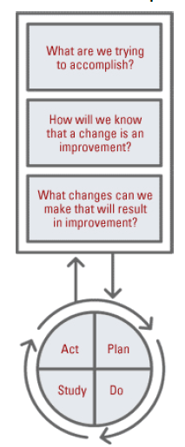
The Model for Improvement
Developed by Associates in Process Improvement
Used by the Institute for Healthcare Improvement (IHI)
The IHI Improvement Project Planning Form http://bit.ly/1IhzWZ7
The Science of Improvement: How to Improve

Slide 57
What are we trying to accomplish?
Based on:
  Staff perceptions/insights of needed improvements
  Patient surveys
  Chart reviews
  Ambulatory Health IT-enabled Quality Improvement Worksheet (http://bit.ly/1KB3Xny)
Start small, narrow focus
  One clinical area
  Authority and resources to make changes

Slide 58
How will we know that a change is an improvement?
Determine data source
  Chart reviews on samples of patients
  Patient registries
  EHR data
  Patient surveys
Share results

Slide 59
What changes can we make that will result in improvement?
“All improvement requires change but not all changes result in improvement.”
Sources for ideas for change:
  Creative problem solving
  Insights of those who work in the system
  Scientific literature
  Borrowing from others who have successfully improved

Slide 60
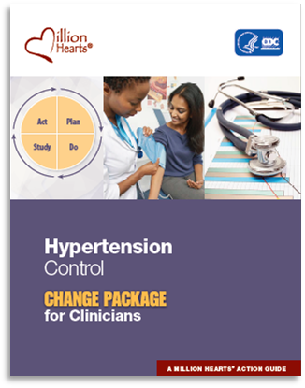
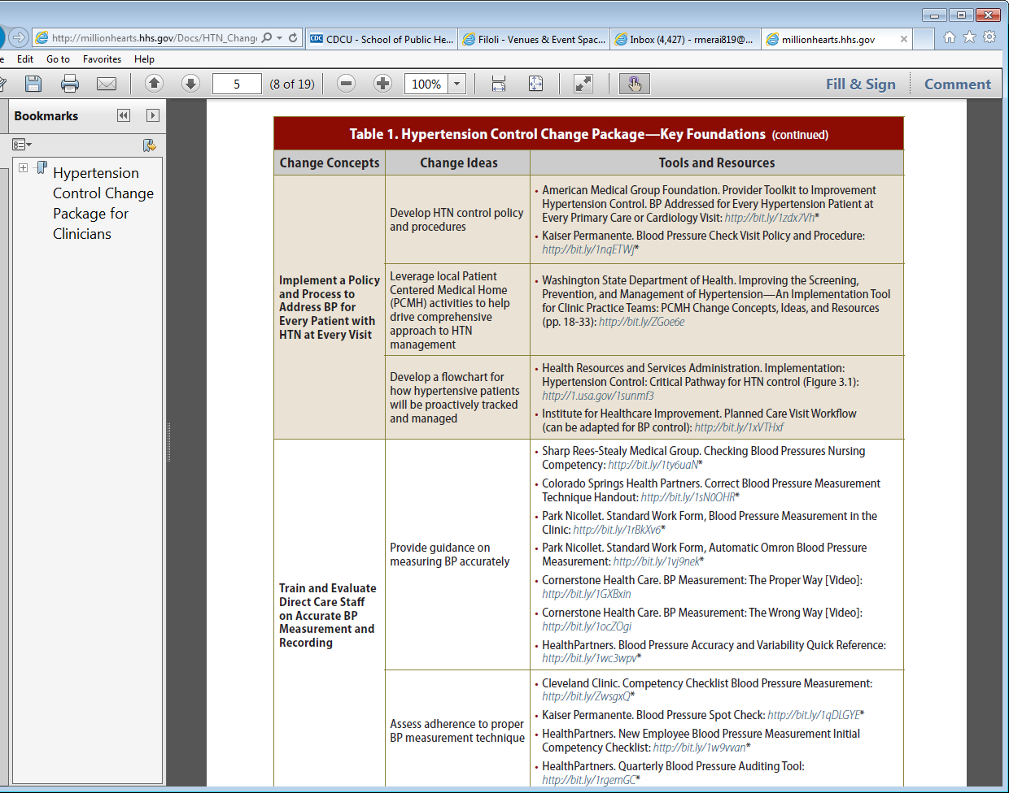
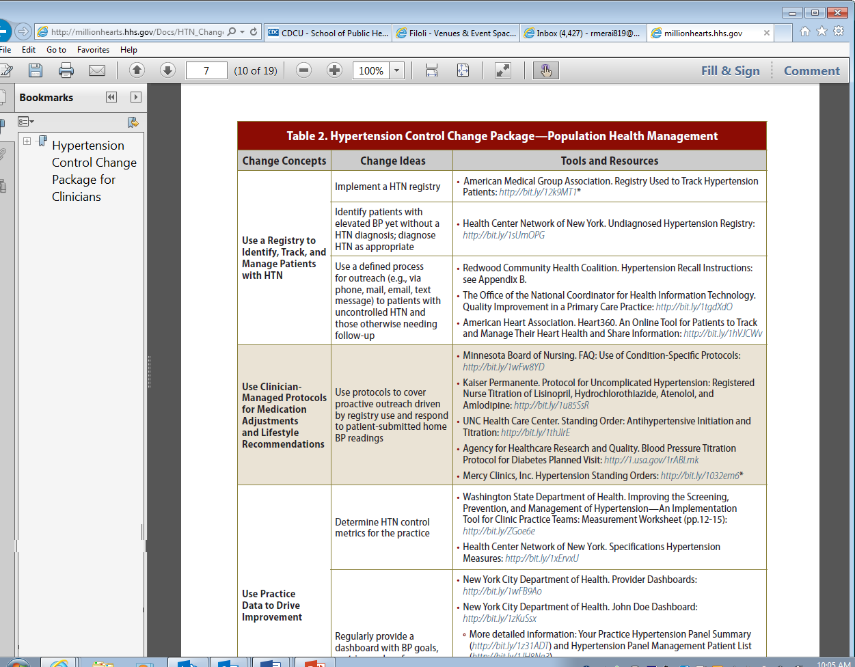
Hypertension Control Change Package
A “change package” is an evidence-based set of changes critical to the improvement of a care process.
http://millionhearts.hhs.gov/Docs/HTN_Change_Package.pdf

Slide 61
Make HTN Control a Practice-wide Priority
Change Concept
General notions that are useful in the development of more specific ideas for changes that lead to improvement
Change Idea
Actionable, specific ideas for changing a process
Tools & Resources
Can be adapted by or adopted in a health care setting
Ensure Care Team Engagement in HTN Control
Washington State DOH Implementation Tool for Clinic Practice Teams

Slide 62
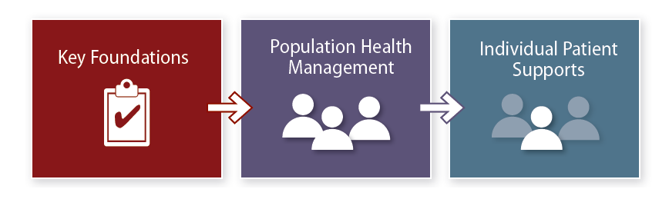
Hypertension Control Change Package Focus Areas
Key foundations
Population health management
Individual patient supports
→ Hypertension control case studies

Slide 63
Key Foundations
“Every visit is a BP visit”
Change Concepts:
  Make hypertension control a practice priority
  Implement a policy to address blood pressure in every patient with hypertension at every visit
  Train staff to accurately measure and record BPs
  Use evidence-based treatment protocols
  Equip and empower staff to help patients self-manage

Slide 64
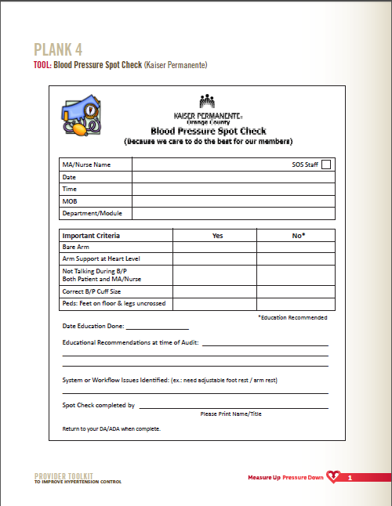
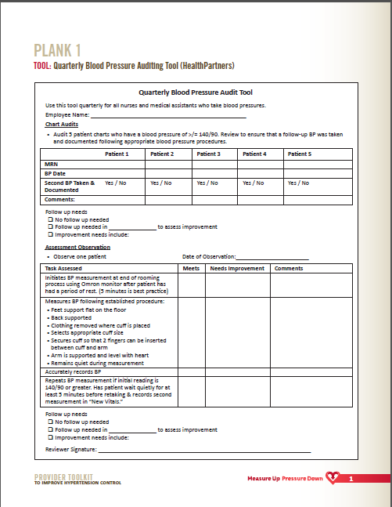
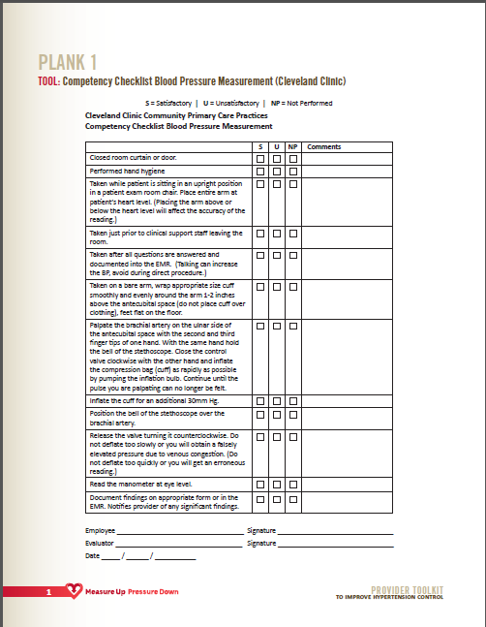
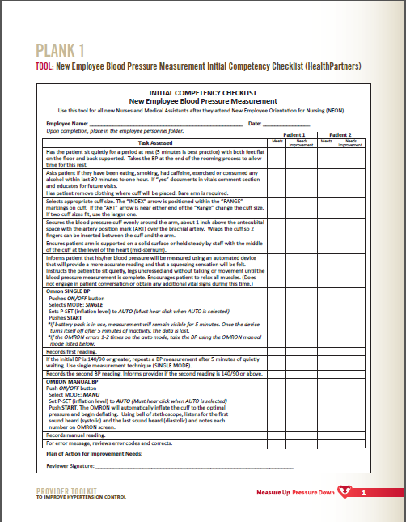
Change Concept
  Train And Evaluate Direct Care Staff On Accurate Blood Pressure Measurement And Recording
1. Provide Guidance On Measuring BP Accurately
2. Assess Adherence To Proper BP Measurement Technique
Change Idea
Tools & Resources

Slide 65
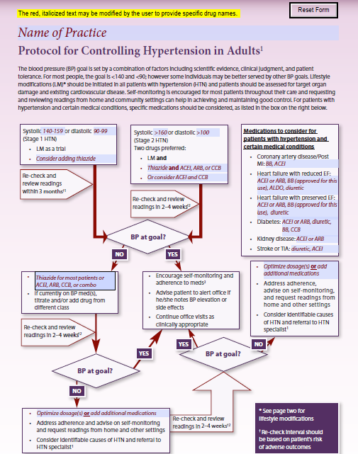
How Can a Protocol Help?
Move 10M More People with Hypertension into the Safe Zone
Expands the care team that can assist in achieving control
Standardizes the content and delivery of lifestyle modification advice
Lends clarity, efficiency, and cost-effectiveness to selection of meds
Specifies intervals and processes for patient follow up
Notes:
Payer actions: promote as best practice, help with e-version?

Slide 66
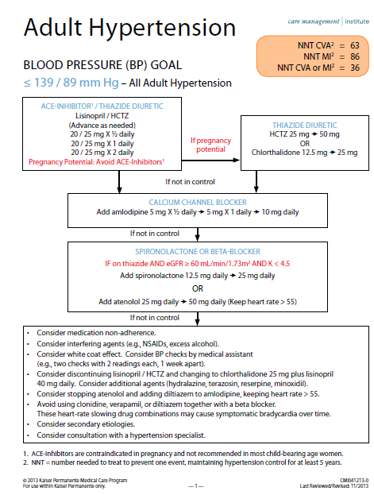
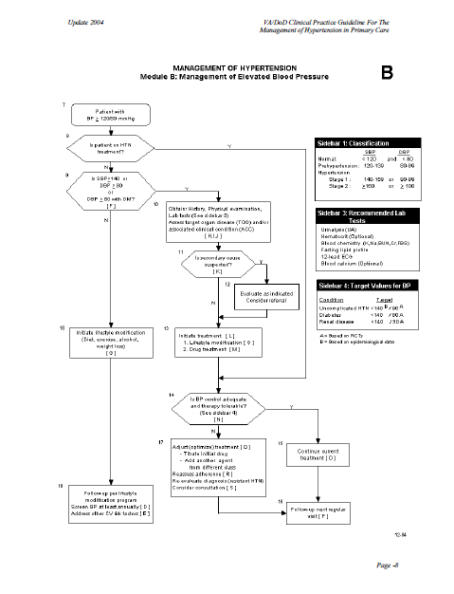
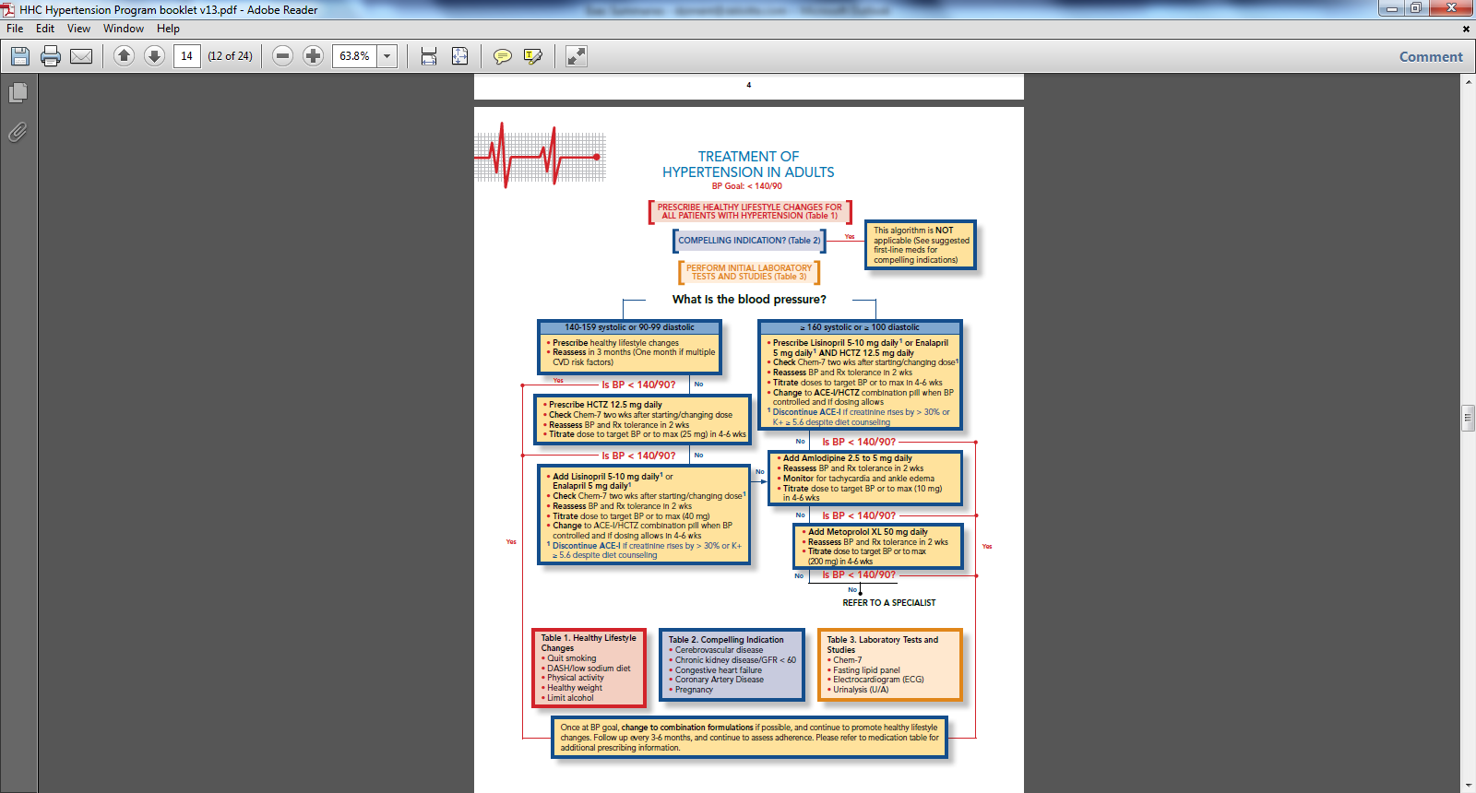
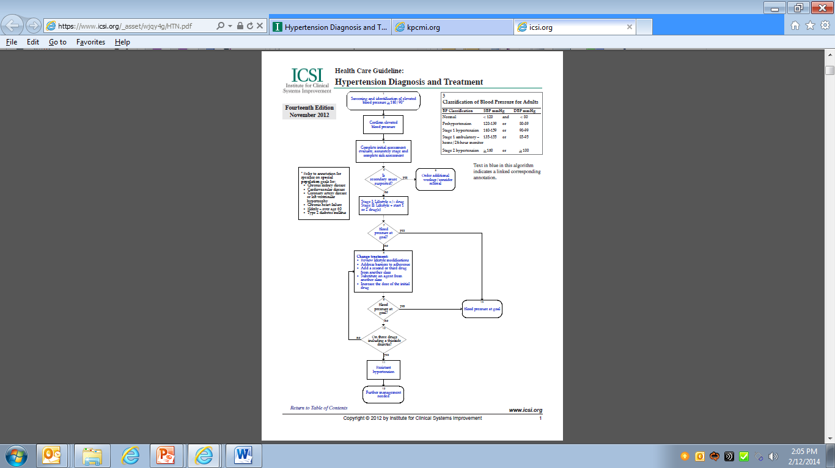
How Does a Protocol Improve Control?
Move 10M More People with Hypertension into the Safe Zone
Outlines process for management of patients resistant to treatment
Raises patient and team “radar” about hypertension
Reduces variation in clinical practice
and ensures evidence-based care for
all patients with hypertension

Slide 67
Protocol Implementation:
How Can A Practice Get Started?
Make decisions about roles, content, meds, more
  Workflow of BP measurement and recording
  What lifestyle advice will you give? By whom? When? How?
  Which medications will you use and at what dosages?
  What are your target goals and for what ages?
  How often to re-check and titrate? Who does this? How?
  How will you define and manage resistance?
Track implementation weekly; share monthly control rates
Celebrate your success along the way

Slide 68
Standardized Treatment Protocols Can Help Reduce Disparate Outcomes
Kaiser Permanente Southern California
% = Controlled
83%
84%
73%
80%
71%
64%
“To help ensure homogeneity of practice delivered, the hypertension treatment had to be standardized as well. This meant that an internal treatment guideline was needed.”
54%
Sim, et al. Canadian Journal of Cardiology 30 (2014) 544-552
Notes:
“To help ensure homogeneity of practice delivered, the hypertension treatment had to be standardized as well. This meant that an internal treatment guideline was needed.”

Slide 69
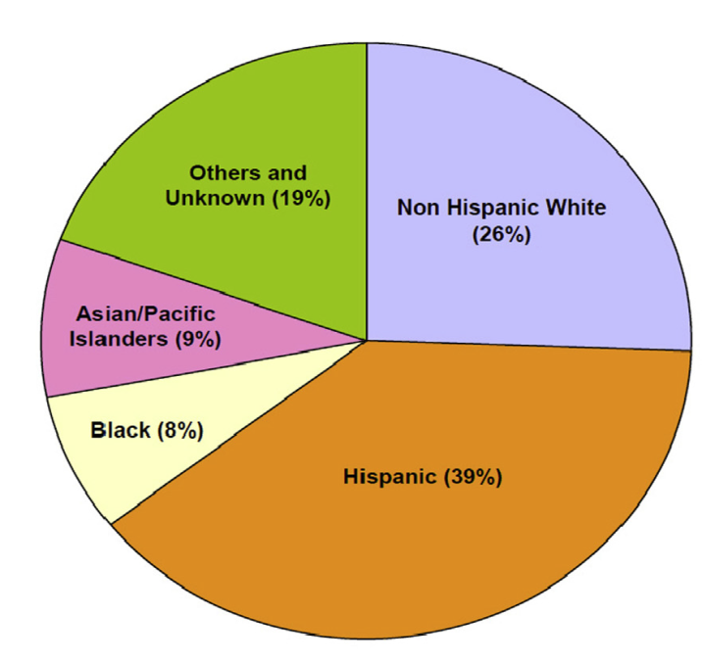
Standardized Treatment Protocols Can Help Reduce Disparate Outcomes
Kaiser Permanente Southern California
“Across all ages, races, and sexes, hypertension control has exceeded 80%.”
85.0% BP control
86.6% BP control
87.9% BP control
81.4% BP control
85.0% BP control
Shaw KM, Handler J, Wall HK, Kanter MH. Improving Blood Pressure Control in a Large Multiethnic California Population Through Changes in Health Care Delivery, 2004–2012. Prev Chronic Dis 2014;11:140173. DOI: http://dx.doi.org/10.5888/pcd11.140173

Slide 70
Population Health Management
Change Concepts:
  Use a registry to identify, track, and proactively manage
  Use a protocol for medication adjustment and lifestyle recommendations
  Use practice data to drive improvement

Slide 71
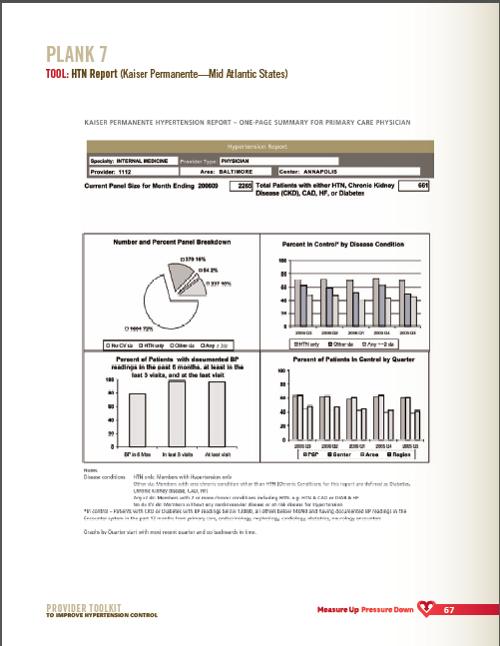
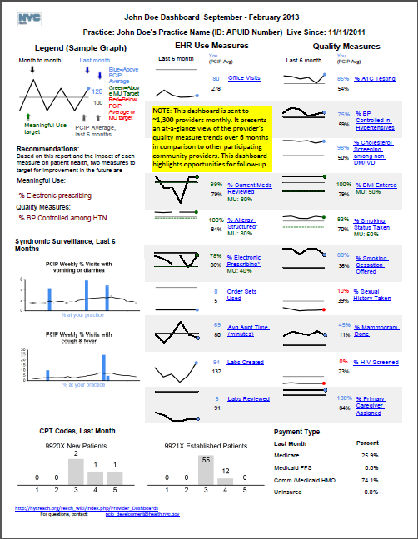
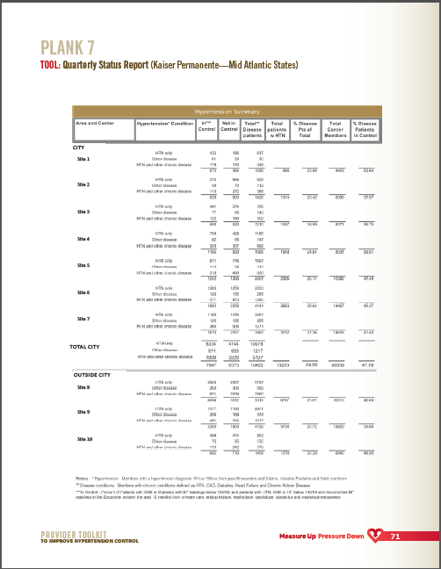
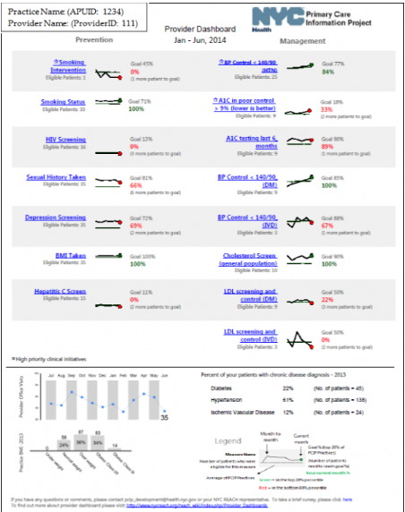
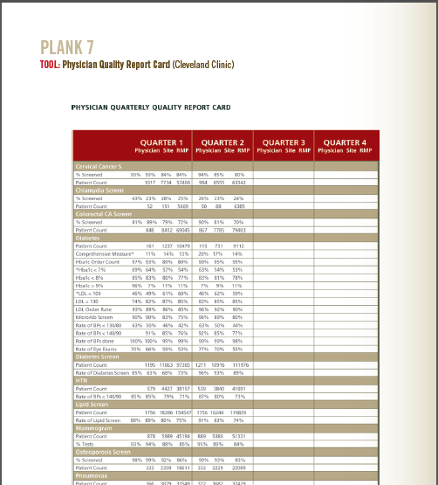
Change Concept
  Use Practice Data To Drive Improvement
1. Determine HTN Control Metrics For The Practice
2. Regularly Provide A Dashboard With BP Goals, Metrics, And Performance
Change Idea
Tools & Resources

Slide 72
Individual Patient Supports
Change Concepts:
  Support patients in hypertension self-management
  Prepare patients and care team before office visits
  Use opportunities during each visit to optimize BP
    Intake
    Clinician Encounter
    Encounter Closing
  Follow up visits to monitor and reinforce plan

Slide 73
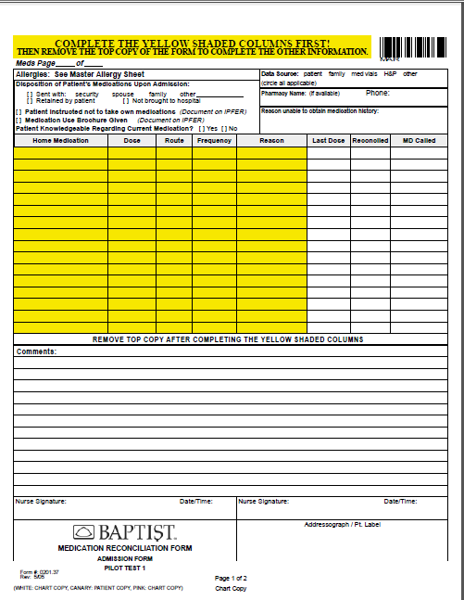
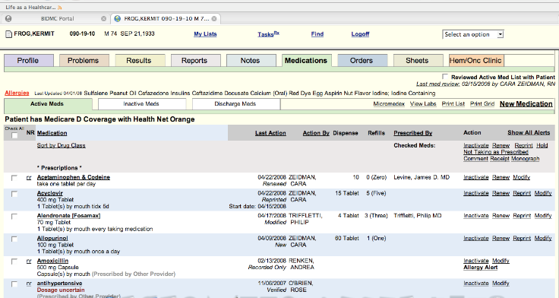
Change Concept
  Use Each Patient Visit Phase to Optimize HTN Management: Intake (e.g., check-in, waiting, rooming)
1. Provide patients with educational materials to help them understand HTN and its implications
2. Provide patient with tools to support their visit agenda and goal setting
3. Measure, document and repeat BP correctly as indicated; flag abnormal readings
4. Reconcile medications patient is actually taking with the record’s medication list
Change Idea
Tools & Resources

Slide 74
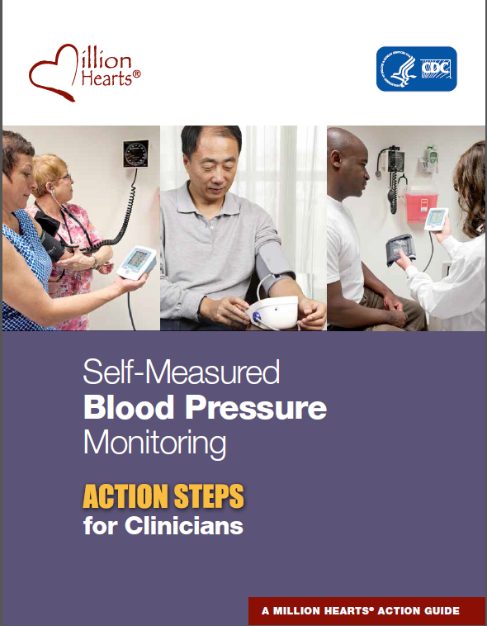
Self-Measured Blood Pressure Monitoring: Action Steps for Clinicians
Guidance for clinicians on SMBP
Teach patients to use monitors
Check home machines for accuracy
Suggested protocol for home monitoring
Guidance on establishing a patient-clinician feedback loop
http://millionhearts.hhs.gov/Docs/MH_SMBP_Clinicians.pdf

Slide 75
Hypertension Control Recap:
What Do High Performers Do?
Prioritize hypertension control
Deploy a team—working off the same playbook
  Connect clinical and community resources to help people achieve & maintain control
Recognize and reward patients and staff
Make the EHR a quality tool
  Use a list or registry to reach out to those who are uncontrolled
  Return timely performance data to the team—and the patient
  Use a patient portal for prompt exchange of readings and advice
  Comb through EHR data for those with elevated BP readings and no diagnosis. Millions are at risk “hiding in plain sight”

Slide 76
Hypertension Control Recap:
What Do High Performers Do?
Eliminate or minimize obstacles to good control
  Ensure accuracy in BP measurement
    Train staff on proper technique and monitor competence
    Check equipment periodically for accuracy and wear
    Request to validate home monitors against office device
  Teach patients how to self-monitor using validated devices, transmit readings, and receive clinical advice
  Alert clinicians to patterns of high BP readings, using EHR alerts, magnet on the door, registry report

Slide 77
Hypertension Control Recap:
What Do High Performers Do?
Eliminate or minimize obstacles to good control
  Emphasize med adherence
    prescribe 90 day supplies
    simplify regimen
    synchronize refills
    pick a pharmacy “home”
    use a pillbox
  Assign one staff person the responsibility of managing med refill requests
  Eliminate cost-share for BP checks and when possible, provide monitors

Slide 78
Million Hearts® Resources
Hypertension and Tobacco Cessation Treatment Protocols
Finding those with Undiagnosed Hypertension
John’s Story” video: How I came back from a heart attack
“It Takes a Team” video for Clinicians and Staff from AMGA
Action Steps and Guides
  Hypertension Control Change Package
  Self-Measured Blood Pressure Monitoring
  Hypertension Action Steps for Clinicians
  Hypertension Action Steps for Employers
Hypertension Control Champions
  100 Congregations for Million Hearts
Million Hearts Healthy Eating & Lifestyle Resource Center
“Million Hearts® E-update: SIGN UP TODAY!
Notes:
John’s Story video includes footage and content on cardiac rehab
78

Slide 79


Join Us
Subscribe—and Contribute to-- the E-Update
Become a Partner
Be One in a Million Hearts®
millionhearts.hhs.gov

Slide 80
Q & A
Group Interaction

Slide 81
LUNCH BREAK

Slide 82

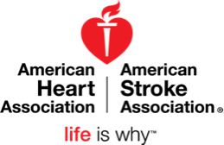
Overview of the
American Heart Association and
Programs and Resources
that align with Million Hearts®

Slide 83
Mission
Building healthier lives, free of cardiovascular diseases and stroke.
Our 2020 Impact Goal
By 2020 to improve the cardiovascular health of all Americans by 20% while reducing deaths from cardiovascular diseases and stroke by 20%.
Notes:
Set tone – here is our mission
Our 2020 impact goal
Factors we are looking at to get at improved cardiovascular health of all Americans by 2020
- A mixture of health factors and health behaviors – otherwise known as life simple 7:
- Smoking, physical activity, health diet, bmi, cholesterol, blood pressure, glucose

Slide 84
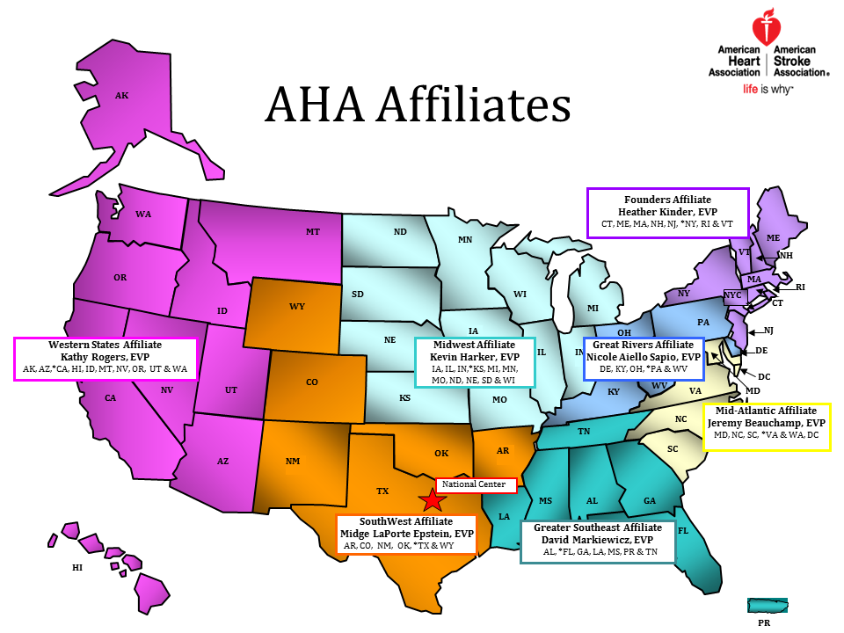
Notes:
Structure
Headquarters Dallas
seven affiliates
3,000 staff members;
150 office across the country
Each office slightly different
Roles may include:
Advocacy
Communications
Community Health
Development
Leadership
Multicultural
Quality
Other
Address VA

Slide 85
Building a Culture of Health
A culture in which people live, work, learn, play and pray in environments that support healthy behaviors, timely quality care and overall well-being.
Notes:
Building a culture of health –
To achieve this, we must work together, in partnership to make the healthy choice the easy choice in all the places where we live, work, learn, play, pray and heal.
To impact millions, we must focus on more than just individual behavior change
Need scalable, sustainable, and equity-addressing solutions.
Focus on focus on improving environments through policy and systems change and address social determinants of health

Slide 86
AHA and Million Hearts®
Spotlight on Idaho
Advocacy Priorities
Health Insurance Coverage - Close the Gap
Time Sensitive Emergencies - Stroke and STEMI Designations and Registries
Healthy and Active Programs - Safe Routes to School, P.E.
Tobacco Free – Smoke Free Air, Tobacco Free Idaho, Tobacco to 21
Notes:
Will discuss the different projects/ policies AHA is focused on and potential for collaboration with partners

Slide 87
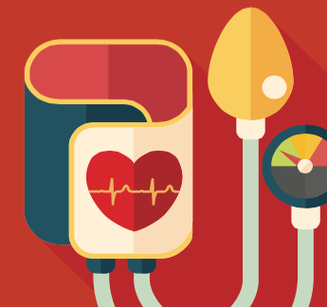

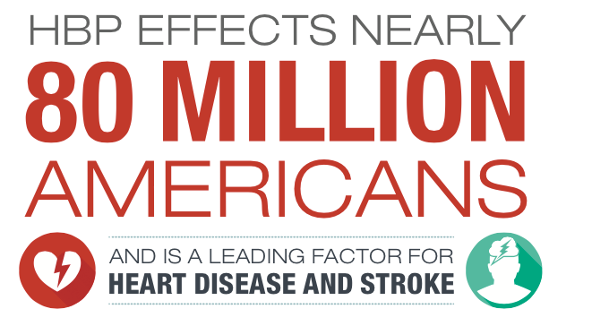
Advancing Million Hearts®:
AHA and Heart Disease and Stroke Prevention
Partners Working Together in Idaho
July 27, 2016
Notes:
Thank you for talking with us about this critical issue of high blood pressure which is a leading factor for heart disease and stroke, some of our nation’s causes of disability and death.

Slide 88

AHA | ASA 2020 Goal
Improve the CV health of all Americans by 20% while reducing deaths from CV diseases and stroke by 20%.
AHA 2020 GOAL
2010
Reduce CHD, stroke, and risk by 25%.
2020
Move 13.6 million Americans to control their HBP
2010
2020
Notes:
The American Heart Association has set a goal of improving the cardiovascular health of all Americans by 20% by 2020 and decreasing the mortality from cardiovascular disease and stroke by 20% by 2020.

Slide 89
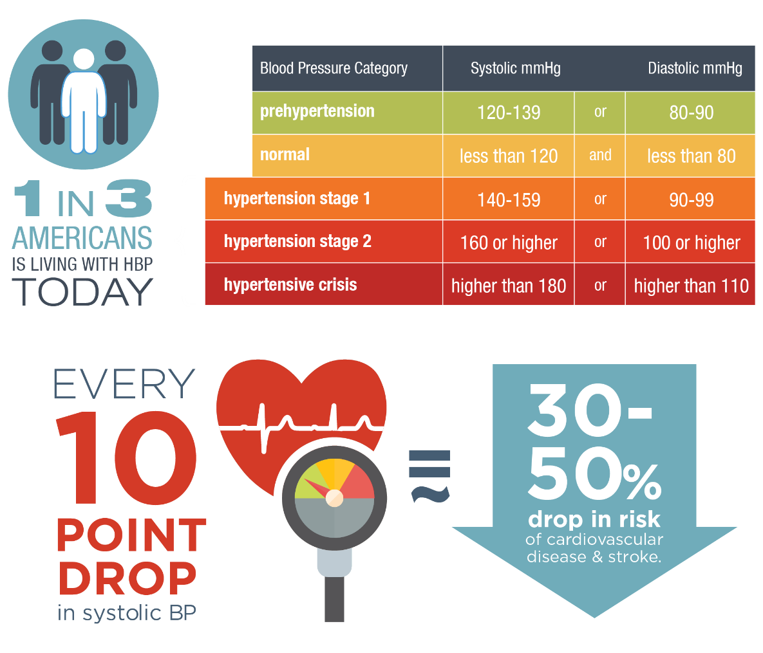
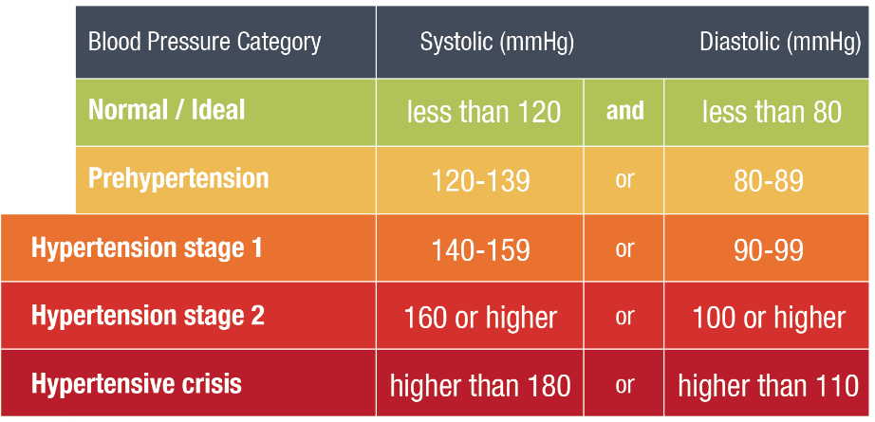
The Urgency
Around
High Blood Pressure Control
80 million adults have HBP
AHA 2015 Statistical Update
Notes:
WHY?
First off, I wanted to share AHA’s road map for achieving our goal of moving millions – 13.6 million – to control by 2020. Recognizing the urgent need to address inadequate control, the American Heart Association (AHA) has made hypertension a primary focus area of its 2014 to 2017 strategic plan, because of the 2020 goal.
Today’s BP Control Statistics tell us:
80 million adults have HBP, which –even with advancements we’ve made– is still one in three or 32.6% of the adult population in the US.
Improving these numbers through better BP control directly translates to drop in risk of cardiovascular disease and stroke.

Slide 90
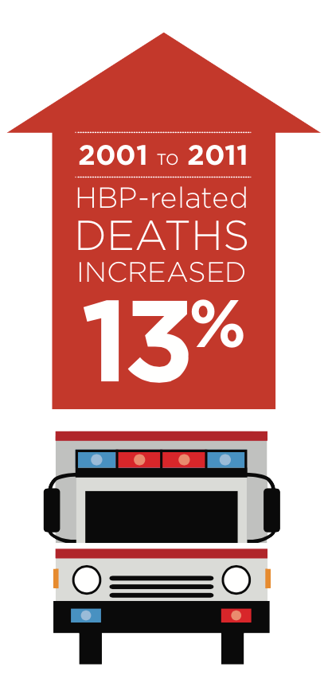
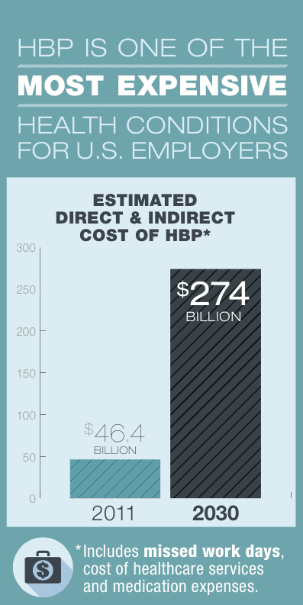
The Urgency
Around
High Blood Pressure Control
AHA 2015 Statistical Update
Notes:
It’s one of the most expensive conditions for U.S. Employers and predictions indicate a greater than 5-fold increase over the next decade.

Slide 91
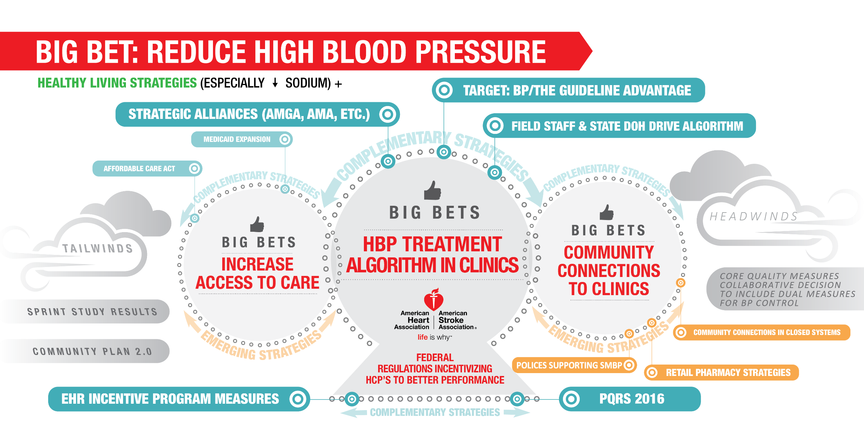
Notes:
Our plan is comprehensive and seeks to attack the issue of hypertension from multiple angles of influence … beginning with:
Equipping Providers – much of this work is around the standardization of protocols.
We also are working through direct to consumer channels to motivate individuals to take hypertension seriously and connect them with resources and tools to help develop habits like self-monitoring and make important lifestyle changes like the decrease of sodium intake.
In communities, we are seeking to reach underserved populations working with stakeholders at churches, community centers, clinics and housing to support individuals in making the changes they need to make to get their blood pressure under control.
And finally, looking at the system of care, ensuring systems are set-up to make hypertension management targeted and easier for healthcare providers.

Slide 92

Check. Change. Control.TM
Notes:
So here’s why we’re here:
To show you what’s exciting about Check. Change. Control.
To define the volunteer mentor’s role
Learn about Heart360 and how you will use it as an engagement and communication tool with program participants
and To highlight your Volunteer Mentor Resources

Slide 93


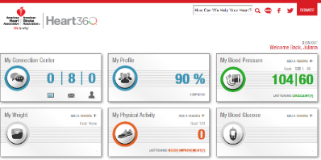
Building a Sustainable HBP Program
Clinical Pharmacists 2008 – 2010 | Community Settings 2010 - 2011 | Enlisting Partners 2012 - Present | Innovation in the Field 2012 - 2013
Remote Monitoring Study via Kaiser Clinical Pharmacists Six month SBP control significantly higher than control group. Suggests healthcare cost saving | Check It. Change It. Community-based intervention in Durham County In patients that began the study with a BP of > 150/90, systolic BP decreased by 24.2 mmHg and diastolic BP decreased by 10 mmHg. | AHA joined with Million Hearts to host a forum that included partners across industries positioned to impact the issue of HBP Initial meeting was the impetus for the launch of AHA’s HBP Leadership Community based on attendees’ desire to continue the innovation, sharing and exchange of solutions | Check It. Change It. set the stage for larger, community-based model run by the AHA focused on high-risk pop. Grants to local market staff designated for rapid development, execution and testing of programs using partners and volunteers. Similar results to Check It. Change It. Lowering BP by 5 mmHG, with more significant drops between 11mmgHG and 26 mHG in high risk groups

Slide 94
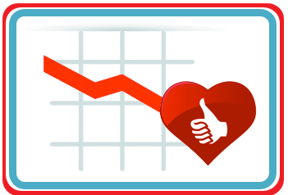
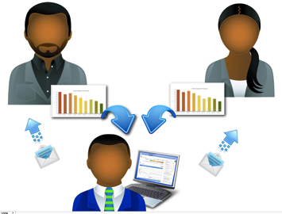

Why it Works: Key Evidence-Based Scientific Principles
Self Monitoring Makes a Difference
Proven track record for taking blood pressure readings
at home or outside of the healthcare provider office setting.
Use of digital self-monitoring and communication tool
Charting & tracking improves self-management skills related
to blood pressure management
Personal Interaction Makes a Difference
Health mentors can motivate and encourage participants.
Multicultural Program Investments Make a Difference
Hypertension creates a health disparity for African-Americans.
Check. Change. Control.
Notes:
Here’s why Check. Change. Control. is likely to be successful.
Because self-monitoring makes a difference.
Personal interaction makes a difference.
And multicultural program investments make a difference.
These are proven ways to make a positive impact.

Slide 95



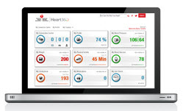
Program Components
Community Partners with Shared Goals to Drive BP Control
Since August, 2012 over 46,000 participants have enrolled in Heart360
Campaign Results*:
Average drop in Systolic BP:
11.02 mm Hg
Average drop in Diastolic BP:
7.68 mm Hg
Innovative Implementation Across Markets
Health Mentors Encourage Participants to Track Weekly Readings for 4 Months
Central BP Tracking Tool for Participant Engagement and Data Collection
Notes:
As of the end of June 2014, over 20,000 participants and 2,400 volunteer health mentors have participated in the program, which has grown to 175 programs in over 70 markets. The goal initially was to have 30,000 African Americans enrolled in an evidence based blood pressure program by 2014. The innovative approaches and program models have been a rich source of information, which is currently being evaluated. Some highlights of the blood pressure data have been consistent with the Check it, Change it data.
Analysis for 2013 showed BPs trending down among participants with elevated readings at baseline, some sampling of these results include:
Average drop in blood pressure was 5.68/2.87;
If blood pressure was > 140/90, average drop was 17.46/7.96;
If participants uploaded 2 readings for 4 consecutive months, the average drop in BP was 11.2/4.31; and
If participants uploaded 2 readings for 4 consecutive months, and started with a BP > 140/90, their average drop was 27.23/10.52
Analysis for 2014 showed BPs continuing to trend down among participants with elevated readings at baseline:
Average drop in blood pressure was 13.9/9.51;
If blood pressure was > 140/90, average drop was 21.94/12.65;
If participants uploaded 2 readings for 4 consecutive months, the average drop in BP was 14.4/9.14;
If participants uploaded 2 readings for 4 consecutive months, and started with a BP > 140.90, average drop was 26.04/9.09

Slide 96

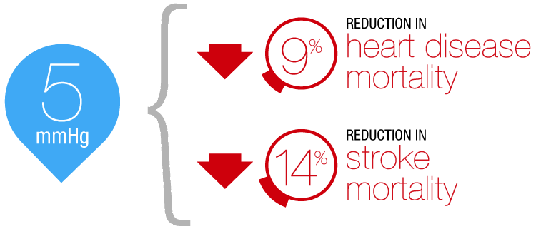
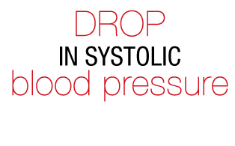
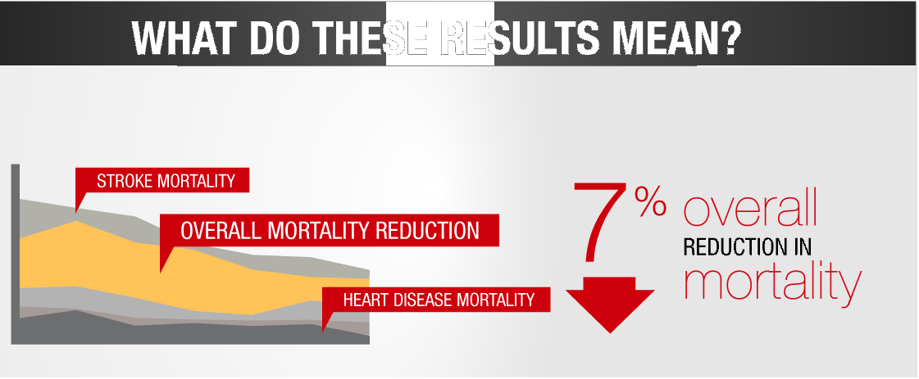
Benefits extend even with partial engagement:
Even those participants who did not meet the full retention criteria saw declines in BP numbers.

Slide 97

Target: BP is a national movement aimed at improving blood pressure control, to reduce the number of Americans who have heart attacks and strokes. Target: BP provides physician practices and health systems resources and support to achieve a 70% blood pressure control rate with a target of achieving 80% or higher.

Slide 98
Why launch Target: BP now?
SPrINT study results
Increased access
to care
Policies incentivize HCP’s
to better control
MH
AHA 2020 goals are imminent
Synergizing with Million Hearts program
Notes:
Just prior to sessions the National Institutes of Health (NIH) reported on the results of the SPRINT Trial, for people age 50 and older with high blood pressure and at least one other risk factor for heart disease, they noted lowering blood pressure to under 120 mm Hg reduced a combined end point of heart attack, acute coronary syndrome, heart failure and strokes by 30% more than lowering it to 140 mm Hg. In addition, deaths from any cause were reduced by 25% in those treated to reach a goal of 120 mm Hg. The study's independent data safety and monitoring board called for the study to be halted because of this significant benefit, which clearly outweighed any harm.
This study was promoted during Sessions and we used the momentum of the SPRINT Trial to draw attention to our new initiative: Target: BP.

Slide 99

What is Target: BP?
✓
A call to action motivating hospitals, medical practices, practitioners and health services organizations to prioritize blood pressure control
Recognition for healthcare providers who attain high levels of blood pressure control in their patient populations, particularly those who achieve 70 or 80 percent control
A source for tools and assets for healthcare providers to use in practice, including the AHA/ACC/CDC Hypertension Treatment Algorithm and the AMA’s M.A.P. Checklist
✓
✓
Notes:
For the last bullet –
The first step is to register healthcare providers in Target: BP. Our goal was to create a simple, quick registration process. Organizational data is provided (name, provider, address) as well as some brief clinical data: number of patients in clinic, number of HBP patients and number of HBP patients controlled to <140/90. Once they register we will provide them with a participation certificate stating they have joined us. Throughout the course of the year we will be reaching out to the sites with information approximately every 3 months (but this is still in the works). In early 2017, we will send a post survey asking them where they are at with their control rates. Recognition will be provided for those that have improved their rates and special recognition for those who obtain 70 and 80% or above.

Slide 100




Tools & Resources for Successful Control
Notes:
Mike this is where you’ll start to talk in depth about the participant resources …
They are very interested in the clinical and training materials for staff … so this can have more time than the next slide which is patient
Click 1: Home page and circle will animate around “participant”
Click 2: Tools and Resources page
Click 3: AHA’s algorithm
Click 4: AMA’s MAP checklist
Click 5: AMA’s podcast image
Click 6: Protocols fact sheet

Slide 101



Tools & Resources for Successful Control
Notes:
Patient resources … materials for the HCP to use in educating patients and families as well as staff.
Click 1: Home Page with animated circle around patient
Click 2: HBP patient
Click 3: SMBP for patients
Click 4: Answers by Heart fact sheet

Slide 102



Elements Associated with Effective Adoption of Protocols
Practice Team-Base Care
Make hypertension control a priority.
Fully use the expertise and scope of practice of every member of the health care team.
Include the patient and family as key members of the team.
Learn about community resources and recommend them to patients.
Conduct pre-visit planning to make the most of the care encounter.
Look for opportunities to check in with patients between visits and adjust medication dose as needed.
Notes:
Join us in our mission …. Make hypertension control a priority.
Fully use the expertise and scope of practice of every member of the health care team: physician, advanced practice nurse, physician’s assistant, nurse, hospital and community pharmacist, medical assistant, care coordinator, and others.
Include the patient and family as key members of the team.
Learn about community resources and recommend them to patients.
Conduct pre-visit planning to make the most of the care encounter, such as ensuring that patients bring in their home readings and ask questions or express concerns, including about access to medications and monitoring equipment, adverse effects of medications, and challenges with diet and exercise.
When hypertension is not controlled, look for opportunities to check in with patients between visits and adjust medication dose as needed.

Slide 103
Tools and Resources
Online Tools
Heart 360
My Life Check
Heart Attack Risk Calculator
High Blood Pressure Risk Calculator
AHA’s Smoking Cessation Tools and Resources
AHA Healthy Workplace Food and Beverage Toolkit July 2016
Resources
EmPowered to Serve
Get With The Guidelines
Check.Change.Control

Slide 104
Discussion
Is there a program you were unaware of that you would like to explore further for implementation or application in the state?
On which topics would you like additional information?
Other questions

Slide 105
Partners Highlighting
Hypertension Programs

Slide 106
Partners, Programs and Persons That Align
Ways to Work Together
and
Next Interactions

Slide 107
How did this meeting benefit you and your organization?
Do you have suggestions on improving the overall format for this meeting?

Slide 108
Thank you for your participation!

